Slide 1
Application Development with Kubernetes and AWS
Application Development with Kubernetes and AWS
Created by Shawn Zernik on 1/4/2024
Slide 1

Slide 2
Application Development with Kubernetes and AWS
Objectives
Provide history and evolution of computing and network environments.
Modern .NET Core application architecture
Containerization
Cloud environment setup
Application deployment
Created by Shawn Zernik on 1/4/2024
Slide 2

Slide 3
Application Development with Kubernetes and AWS
History & Evolution
Created by Shawn Zernik on 1/4/2024
Slide 3

Slide 4
History & Evolution
Centralized to Distributed to Centralized
Computing has evolved from single user single machine, to multiuser, to distributed, and is being consolidated back into data centers.
We had big single user machines that turned into big multiuser mainframes. This is where UNIX and Linux ultimately came from.
We then went distributed to everyone having a computer and a server on there local network.
We are not in a cycle of consolidating those servers back into data centers.
Created by Shawn Zernik on 1/4/2024
Slide 4

Slide 5
History & Evolution
The Latest Technology (1940’s)
In colloquial usage, the terms "Turing-complete" and "Turing-equivalent" are used to mean that any real-world general-purpose computer or computer language can approximately simulate the computational aspects of any other real-world general-purpose computer or computer language.
https://en.wikipedia.org/wiki/Turing_completeness
Emulation (1980’s)
Microsoft wrote BASIC on an 8080 emulator using a DEC PDP-8.
https://www.pbs.org/nerds/qa10.html
Created by Shawn Zernik on 1/4/2024
Slide 5

Slide 6
History & Evolution
Virtualization
Modern virtualization stems from emulation - we are effectively emulating the CPU and hardware the software runs on.
Most servers in classic bare metal models would only be utilized to 25%, 50%, but never up to 100% meaning the remaining utilized capacity is a waster of money, power, and resources.
Virtualization has the following benefits:
Better utilization approaching 100%
Separation and clear boundaries between software packages by no longer sharing operating systems
Abstracting the system from the hardware making moving to new hardware a simple file copy
Created by Shawn Zernik on 1/4/2024
Slide 6

Slide 7
History & Evolution
Virtualization - New Problem
Emulating all hardware is inefficient as computing cycles are used to provide the basic function of the hardware it’s self.
Solution
Hardware and software working together allows the guest system to use the underlying hardware to simulate and separate different ‘virtual computers.’ While this gives a good performance increase bringing the virtualized performance closer to the bare metal performance, it requires that the system being virtualized by compatible with the underlying hardware.
Created by Shawn Zernik on 1/4/2024
Slide 7

Slide 8
History & Evolution
Software Architecture
Software has changed with the internet and continued integration of systems and networks.
Service
Oriented
Architecture
Client
Server
Distributed
Systems
Monolith
Microservices
From
One
Machine
To
Millions
Personal
Computers
Mainframe
Networks
Servers
Internet
Virtualization
Cloud
Big
&
Heavy
Small
&
Light
Centralized
Decentralized
Global
Created by Shawn Zernik on 1/4/2024
Slide 8

Slide 9
History & Evolution
The Next Problem
Virtualization is heavy: we are running 1000s of operating systems; computing resources spent running the same operating system over and over; memory and disk space wasted; human effort to manage and orchestrate.
Solution
The solution started in the 1970’s in the UNIX world. A system called ‘chroot’ would isolate the filesystem. This isolation, also known as sandboxing, continued to sandboxing application execution space. This allowed applications to safely be separated from other applications for testing and security reasons in UNIX like environments.
Ultimately this led to containerization. Rather than virtualize the hardware and spin up another copy of the operating system, we can reuse parts of the operating system in a secure manner that looks like its own system.
https://www.opensourceforu.com/2016/07/many-approaches-sandboxing-linux/
https://medium.com/an-idea/a-brief-history-of-container-virtualization-57fc96c02924
Created by Shawn Zernik on 1/4/2024
Slide 9

Slide 10
History & Evolution
Physical to Containers
Below are the different hardware and software stacks of the different options:
Hardware
Hardware
Hardware
Operating OS
Operating OS
Operating System
Operating System
App
App
App
App
App
App
App
App
Operating OS
Operating OS
App
App
App
App
Bare Metal
Insecure
Inefficient
High Maintenance
Virtualization
Security
Resiliency
Better Utilization
Containerization
Security
Resiliency
Scalability
Created by Shawn Zernik on 1/4/2024
Slide 10

Slide 11
Application Development with Kubernetes and AWS
Technologies
Created by Shawn Zernik on 1/4/2024
Slide 11

Slide 12
Technologies
For the purposes of learning and testing out these new technologies, we are going to try to simulate and boot up an app in AWS using private networks.
Application
We will need an application to containerize. For this purpose, I wrote a simple .NET Core application.
Simple WebApi - provides HTTP endpoints for the UI
Entity Framework - used to provide data access
DacFx Project - allows DB control in GIT and drift protection during publishing
HTML / Javascript UI - a Web2.0 Javascript UI that calls the WebApi for data
Cloud Environment
To simulate a private corporate cloud environment, we have utilized:
AWS - the cloud provider
OpenVpn - provides direct access to the clouds VPC
RDS MS SQL - a fully managed MS SQL database instance
ECR - container registry for publishing to Kubernetes cluster
EKS - the Kubernetes cluster used
DevOps
For development and pipeline operations we have used the following:
GIT - repository to store code
Terraform - used to provision DB and Kubernetes
BASH - scripts used to build and deploy to AWS
VS Code - IDE of choice
Azure Data Studio - SQL client
SqlPackage - publish database changes
Created by Shawn Zernik on 1/4/2024
Slide 12

Slide 13
Application Development with Kubernetes and AWS
WebApi
(htown-msg)
Created by Shawn Zernik on 1/4/2024
Slide 13

Slide 14
WebApi Solution - Architecture
The application is referred to as “Houston Message Board”. It’s intended to be a simplistic stateful application that persists data to a Microsoft SQL database.
Client Side Server Side
Database Context Class
Web Browser
.NET
WebApplication
EndPoint Classes
Page.Html
Entity.Js
Page.Js
Entities
MS SQL
Response
There is no business logic layer here. Normally, between the end points and entities, there should be a business logic layer.
Created by Shawn Zernik on 1/4/2024
Slide 14

Slide 15
WebApi Solution – DotNet Commands
DotNet CLI
Traditionally, you would used Visual Studio to create and manage solutions and projects.
For .NET Core, considering it’s cross platform abilities and Visual Studio is limited to Windows, it provides a command line interface (CLI) that does the management of projects and solutions.
Create Solution
dotnet new sln --name "htown-msg"
Create Project
dotnet new web --framework net8.0 --language "C#" --name "webapi"
Add DacFx SQL Project
dotnet new -i Microsoft.Build.Sql.Templates
dotnet new sqlproj --target-platform "SqlAzureV12" --name "database"
Add Projects to Solution
dotnet sln htown-msg.sln add webapi
dotnet sln htown-msg.sln add database
Search for NuGet Packages
nuget search NAME
Add NuGet to Project dotnet add "webapi.csproj" package Microsoft.Extensions.Logging.Console
Created by Shawn Zernik on 1/4/2024
Slide 15

Slide 16
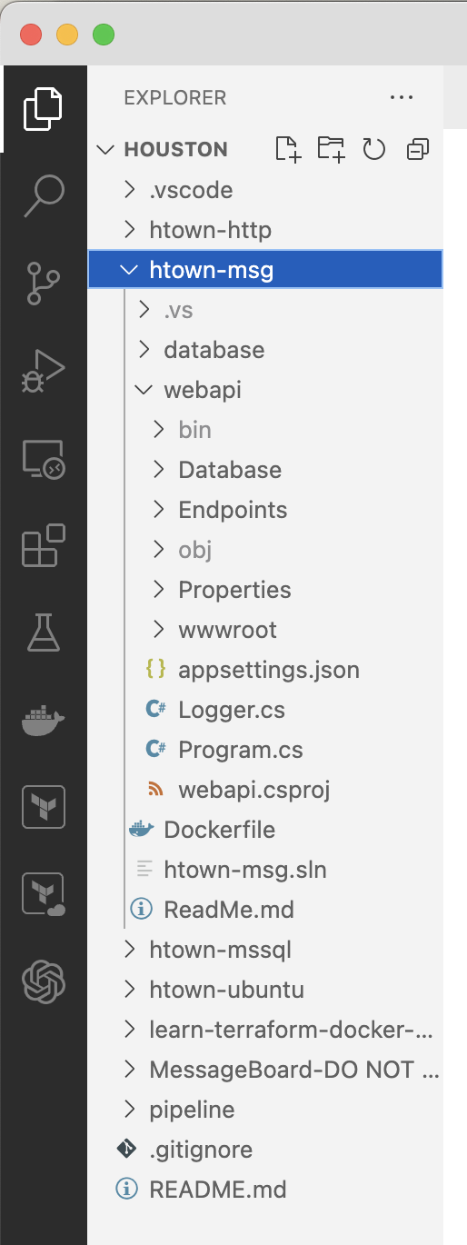
WebApi Solution – Folder Structure
Database Project
The application is broken down into the three components.
WebApi Project
wwwroot
Created by Shawn Zernik on 1/4/2024
Slide 16

Slide 17
Application Development with Kubernetes and AWS
Program
Created by Shawn Zernik on 1/4/2024
Slide 17

Slide 18
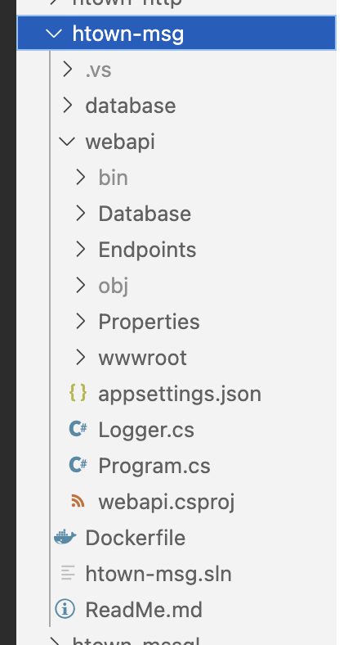
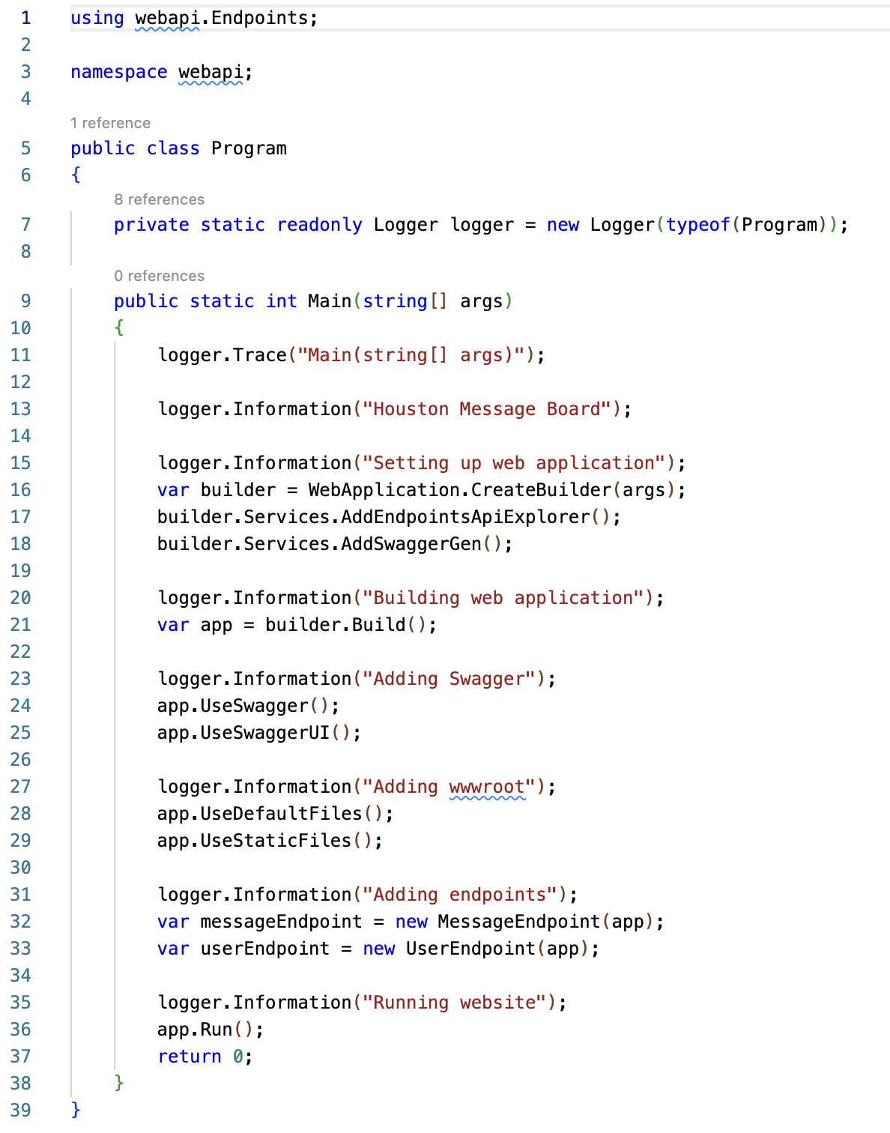
WebApi Solution – Program – Entry Point (main)
The boiler plate code provided was classless.
I inserted the Program class and Main() function.
Created by Shawn Zernik on 1/4/2024
Slide 18

Slide 19
WebApi Solution – Program – WebApplication
Sets up the basic HTTP server.
Created by Shawn Zernik on 1/4/2024
Slide 19

Slide 20
WebApi Solution – Program – Swagger
Swagger acts as a “PostMan” built directly into the web server.
Created by Shawn Zernik on 1/4/2024
Slide 20

Slide 21
WebApi Solution – Program – wwwroot (Static Content)
Add static HTML and JavaScript for user interface.
In a productionized application, static content would be served outside our container – some type of CDN.
We would have to account for CORS – cross origin resource sharing.
Created by Shawn Zernik on 1/4/2024
Slide 21

Slide 22
WebApi Solution – Program – End Points
Passes the web application to end point classes where they bind to URLs.
Created by Shawn Zernik on 1/4/2024
Slide 22

Slide 23
WebApi Solution – Program – Running
Starts the web server.
Created by Shawn Zernik on 1/4/2024
Slide 23

Slide 24
Application Development with Kubernetes and AWS
End Points
Created by Shawn Zernik on 1/4/2024
Slide 24

Slide 25
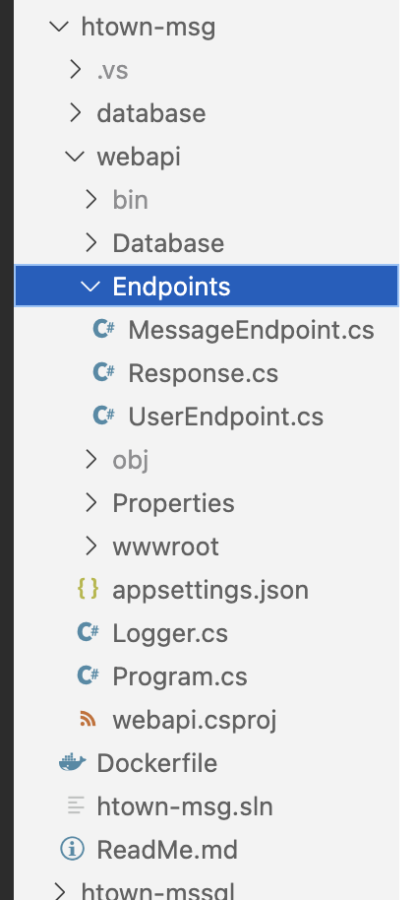
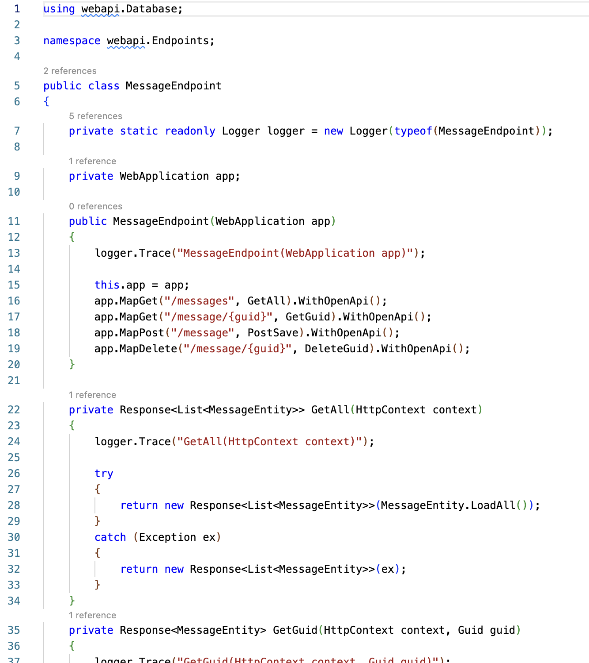
WebApi Solution – End Points – Routes
The constructor binds the end point URLs to member functions.
Map functions represent the HTTP methods the end point will respond to: GET, POST, PUT, DELETE, etc.
WithOpenApi registers the end point with Swagger.
We are also passing parameters in the URL such as {guid}.
Created by Shawn Zernik on 1/4/2024
Slide 25

Slide 26
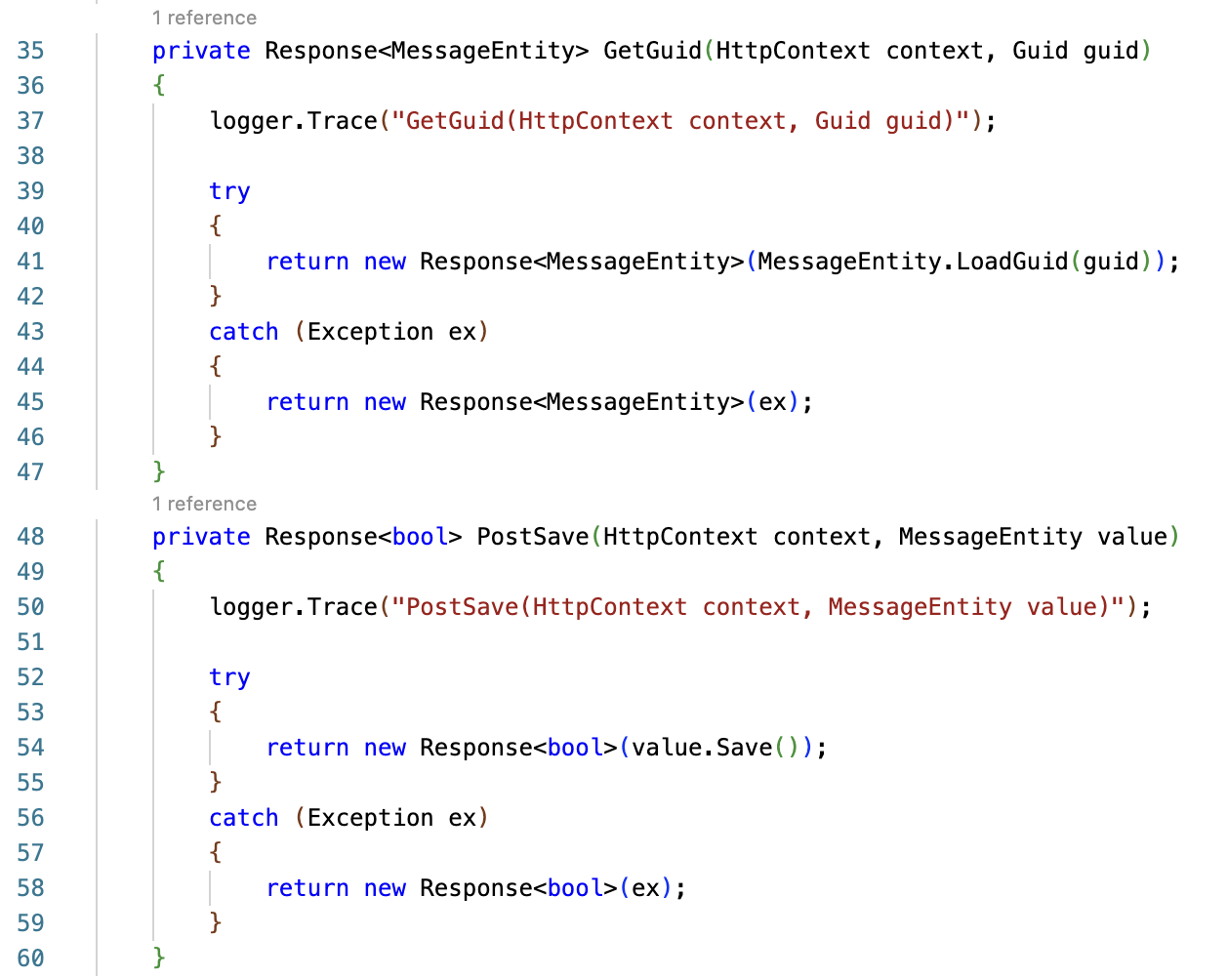
WebApi Solution – End Points – Parameters & Post Bodies
The URL parameter {guid} is being passed into the function.
The post JSON object is deserialized and passed into the function as well.
Created by Shawn Zernik on 1/4/2024
Slide 26

Slide 27
WebApi Solution – End Points – No Business Logic
WebApi end point should contain no business logic or data access.
This has been delegated to our entities.
Created by Shawn Zernik on 1/4/2024
Slide 27

Slide 28
WebApi Solution – End Points – Exception Handling
Exception handling has been added so the user does not get a 500 error if an exception is thrown by the application.
A response will always be returned.
Created by Shawn Zernik on 1/4/2024
Slide 28

Slide 29
Application Development with Kubernetes and AWS
Response
Created by Shawn Zernik on 1/4/2024
Slide 29

Slide 30
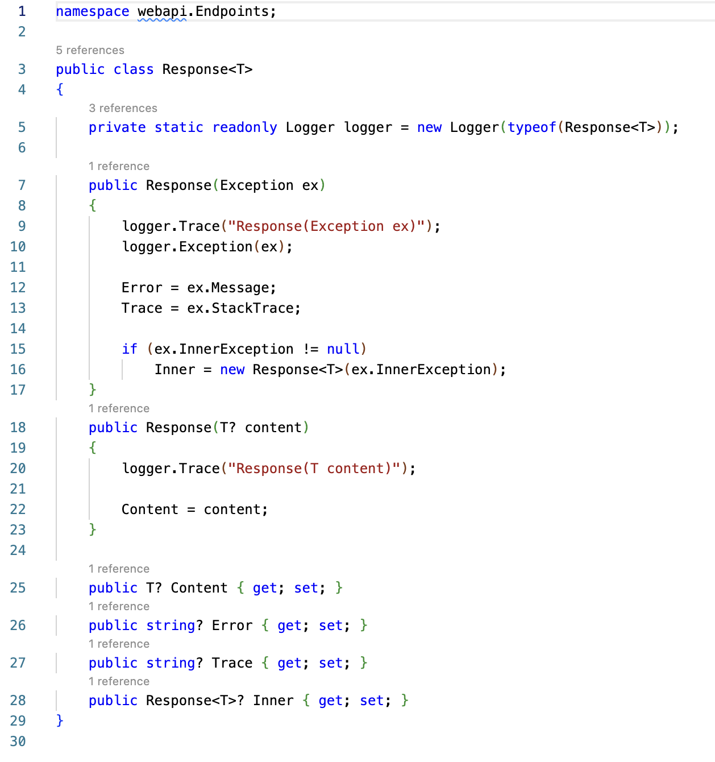
WebApi Solution – Response
When working with Simple WebApis, you can return an object to become the JSON response.
The problem is if an error occurs and an unhandled exception if thrown, the user gets a nasty 500.
We created a generic response object to allow errors/exceptions to be returned to the UI.
Created by Shawn Zernik on 1/4/2024
Slide 30

Slide 31
WebApi Solution – Response
This will be serialized to JSON:
{
content: { … json_object_t … }
error: null
trace: null
inner: { … nested_responses …}
}
Created by Shawn Zernik on 1/4/2024
Slide 31

Slide 32
WebApi Solution – End Points – Success
When we construct a response with object of generic type T, it will populate the “content” property.
Created by Shawn Zernik on 1/4/2024
Slide 32

Slide 33
WebApi Solution – End Points – Exceptions
When we construct a response with an exception, it will capture the error and nested exceptions for the UI.
In a public facing internet site, this is considered insecure.
Created by Shawn Zernik on 1/4/2024
Slide 33

Slide 34
Application Development with Kubernetes and AWS
Entities (EF8)
Created by Shawn Zernik on 1/4/2024
Slide 34

Slide 35
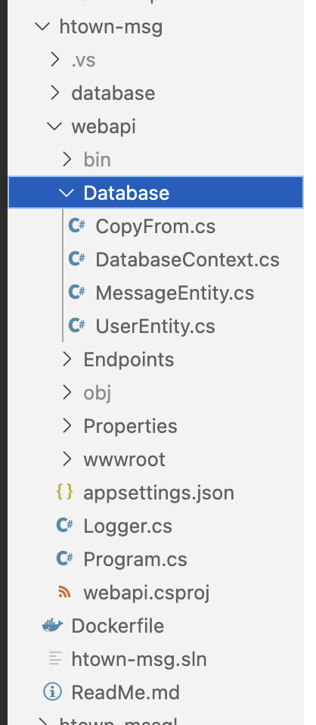
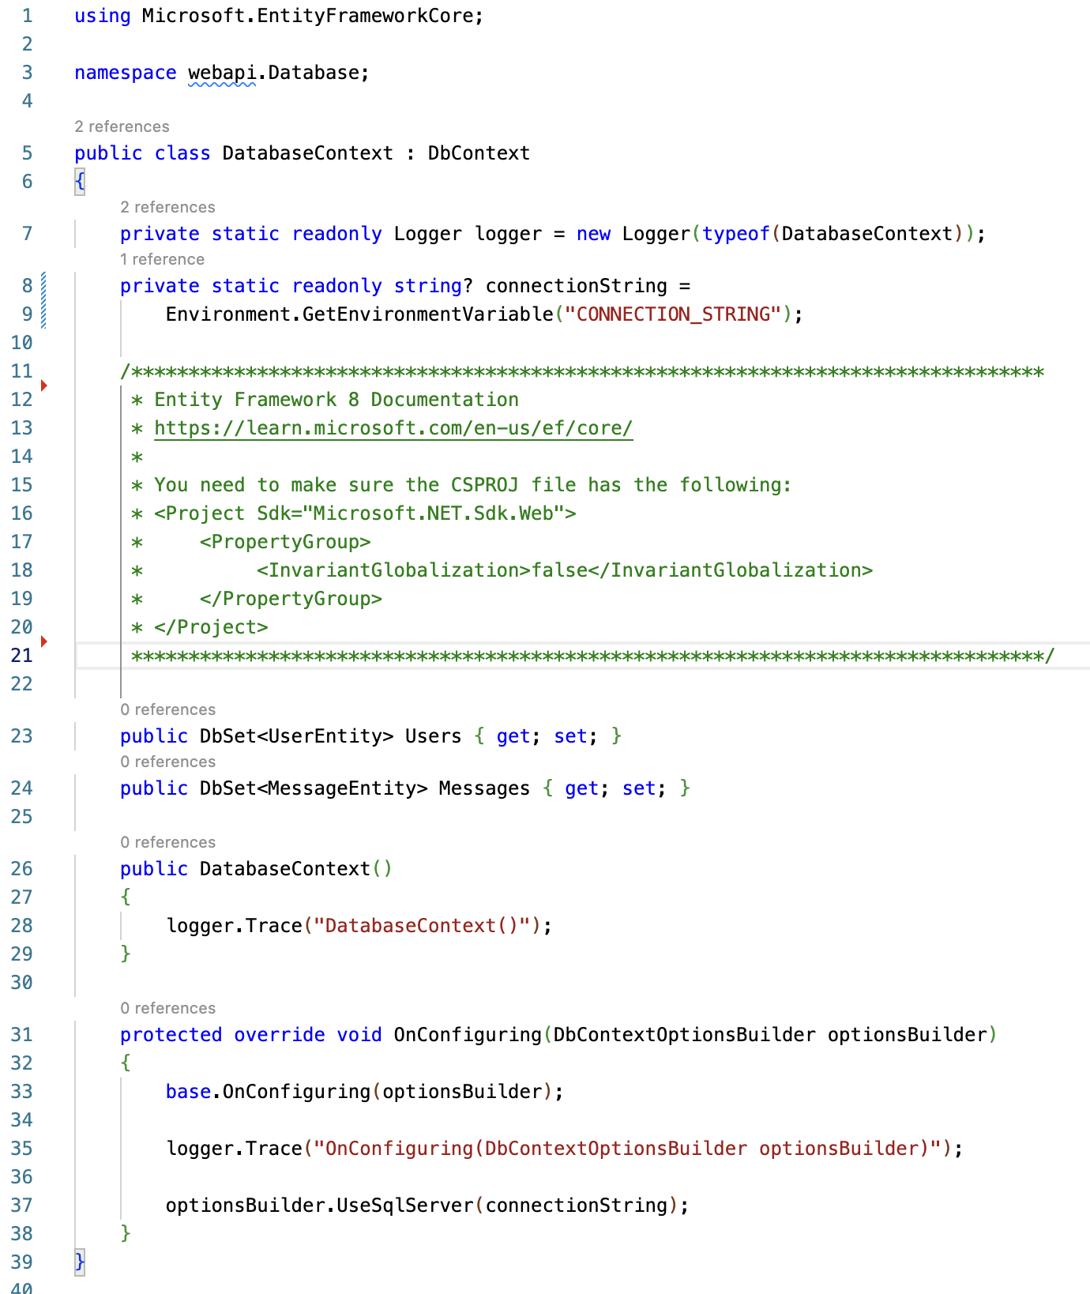
WebApi Solution – Entities
Entity Framework 8
These should have no business logic but should only have data access.
We would expect to see a series of classes for business logic separate from our EF classes.
Examples of business logic would be validating inputs, and/or calculating invoices and taxes.
This application is devoid of business logic.
Created by Shawn Zernik on 1/4/2024
Slide 35

Slide 36
WebApi Solution – Entities - Globalization
Entity Framework 8
If you include EF8, you need to change the “InvariantGlobalization” otherwise your SQL connection will fail.
Created by Shawn Zernik on 1/4/2024
Slide 36

Slide 37
WebApi Solution – Entities – Context
To setup EF8, we need a DbContext class.
This is responsible for the DB connection and tracking the tables it works with.
The context is your starting point for database and table access.
Created by Shawn Zernik on 1/4/2024
Slide 37

Slide 38
WebApi Solution – Entities – Connection
You need to configure your connection string to the database.
Using 12 factor principals, all configuration values should come from the environment.
https://12factor.net/
Created by Shawn Zernik on 1/4/2024
Slide 38

Slide 39
WebApi Solution – Entities – Linking Context to Entities
Each table and entity combination needs to be added to the DbContext.
This allows programmatic access to the entities and table from the context and registers then with the context.
Created by Shawn Zernik on 1/4/2024
Slide 39

Slide 40
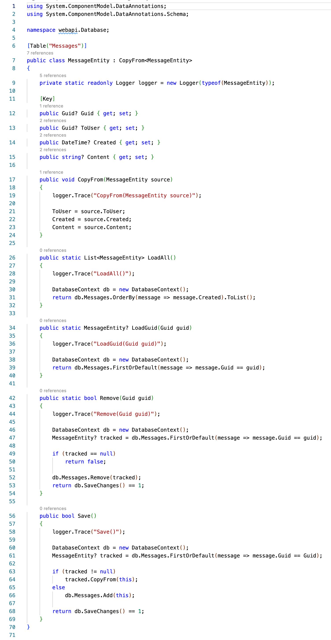
WebApi Solution – Entities – Entity – Implementation
The “Table” annotation is not required if you follow EF8 naming patterns.
I’ve included it to highlight the syntax required when needed.
Created by Shawn Zernik on 1/4/2024
Slide 40

Slide 41
WebApi Solution – Entities – Entity – Primary Keys
When not following common practices – where you “ID” column is a autoincrement big integer, you must annotate the “Key” column.
This is why the “Key” annotation is here – I preffer to use GUIDs as primary keys. I can predict them before inserts.
Created by Shawn Zernik on 1/4/2024
Slide 41

Slide 42
WebApi Solution – Entities – Entity – Untracked
If an entity is not loaded/created directly from the DbContext – it’s “untracked”.
You cannot use the DbContext to persist those entities.
To handle the case where the WebApi gets an entity in the post body and we need to save or update it, I’ve created the “CopyFrom” interface that copies the fields between entities.
Created by Shawn Zernik on 1/4/2024
Slide 42

Slide 43
WebApi Solution – Entities – Entity – Static Data Operations
Loading an entity, or deleting an entity by primary key, we would not have an instance of that entities class.
These data operations are static functions on those entities.
Created by Shawn Zernik on 1/4/2024
Slide 43

Slide 44
WebApi Solution – Entities – Entity – Instance Data Operations
If we have an instance of an entity loaded, the save was implemented using a member instance method.
Created by Shawn Zernik on 1/4/2024
Slide 44

Slide 45
WebApi Solution – Entities – Entity – No Business Logic
Your database entities should not have any business logic.
Keep this strictly data access.
If you need to introduce business logic, you’ll want to use another class for that.
class EntityBizLogic<T> {
EntityBizLogic(T entity);
calculate();
validate();
}
Consult your architect for patterns you should use.
Created by Shawn Zernik on 1/4/2024
Slide 45

Slide 46
Application Development with Kubernetes and AWS
Database Project
(DacFx)
Created by Shawn Zernik on 1/4/2024
Slide 46

Slide 47
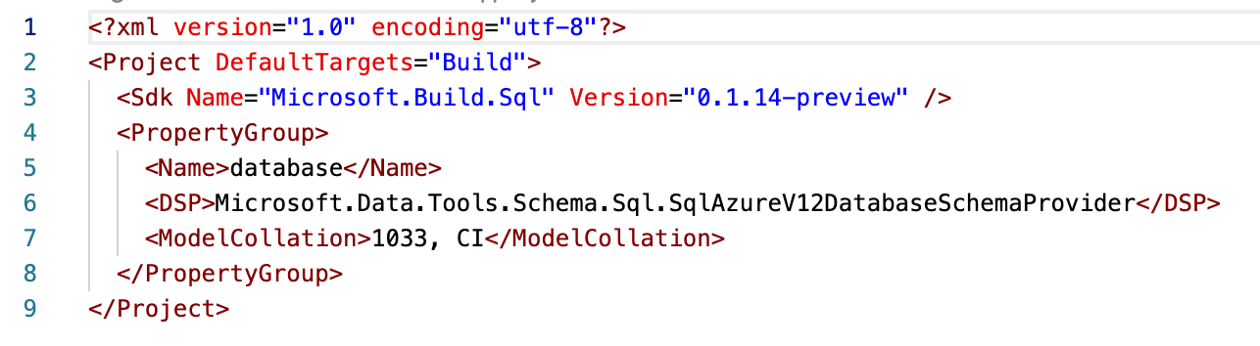
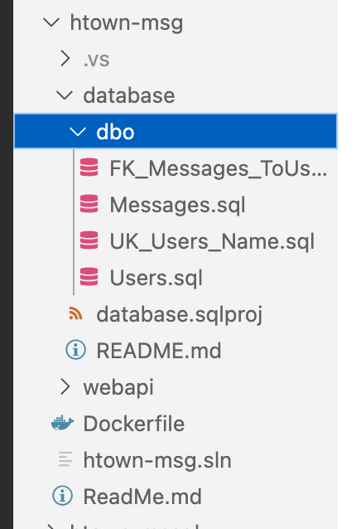
Database Project – Target Server Version
The DotNet CLI will create the ”.sqlproj” file for you.
The critical line to note here is the “<DSP>” as this specifies the target database.
Using Visual Studio can “reverse engineer” a database project for you. Ours was created from scratch.
Created by Shawn Zernik on 1/4/2024
Slide 47

Slide 48
Database Project – File Organization
Common practice is to create a folder for the “schema” – in this case it’s the default schema “dbo”.
Under the schema folder it’s common to create a folder for each SQL objectr type: tables, storedprocs, triggers, functions, etc.
Created by Shawn Zernik on 1/4/2024
Slide 48

Slide 49
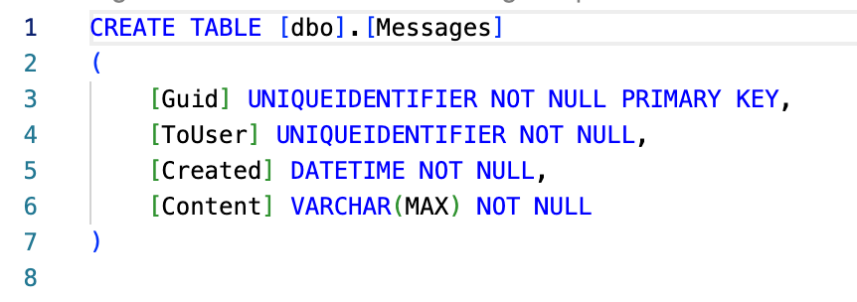
Database Project – SQL Scripts
We will add our tables using standard data definition language (DDL).
When we want to add a new column, you do not write an “ALTER TABLE” query, but instead can update the existing “CREATE TABLE”.
DacFx will do all the magic for you.
Created by Shawn Zernik on 1/4/2024
Slide 49

Slide 50
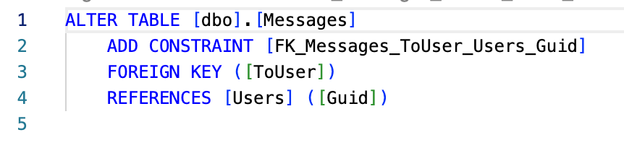
Database Project – Single or Multiple Files
You can combine multiple queries into one SQL. It’s common to separate queries out by SQL object type.
This is an example of the foreign key object.
Created by Shawn Zernik on 1/4/2024
Slide 50

Slide 51
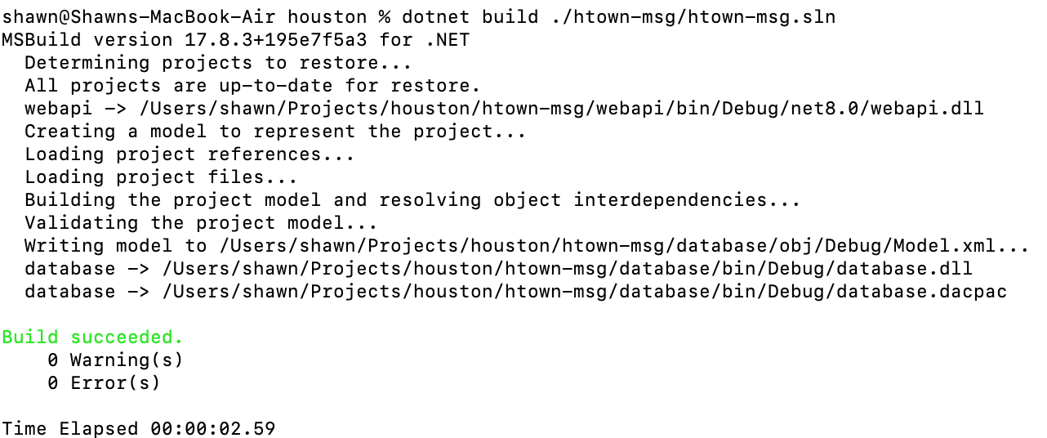
Building the Solution – VS Code
An DacFx project (aka “sqlproj”) will have an artifact of “.dacpac”.
This contains all the database information based on the compiled SQL scripts.
This ”.dacpac” will be used to determine the changes needed to be made on the target database so it matches the definition in the “.dacpac” file.
More to come on that once we get MS SQL running in a container.
Created by Shawn Zernik on 1/4/2024
Slide 51

Slide 52
Application Development with Kubernetes and AWS
Building the Solution
Created by Shawn Zernik on 1/4/2024
Slide 52

Slide 53
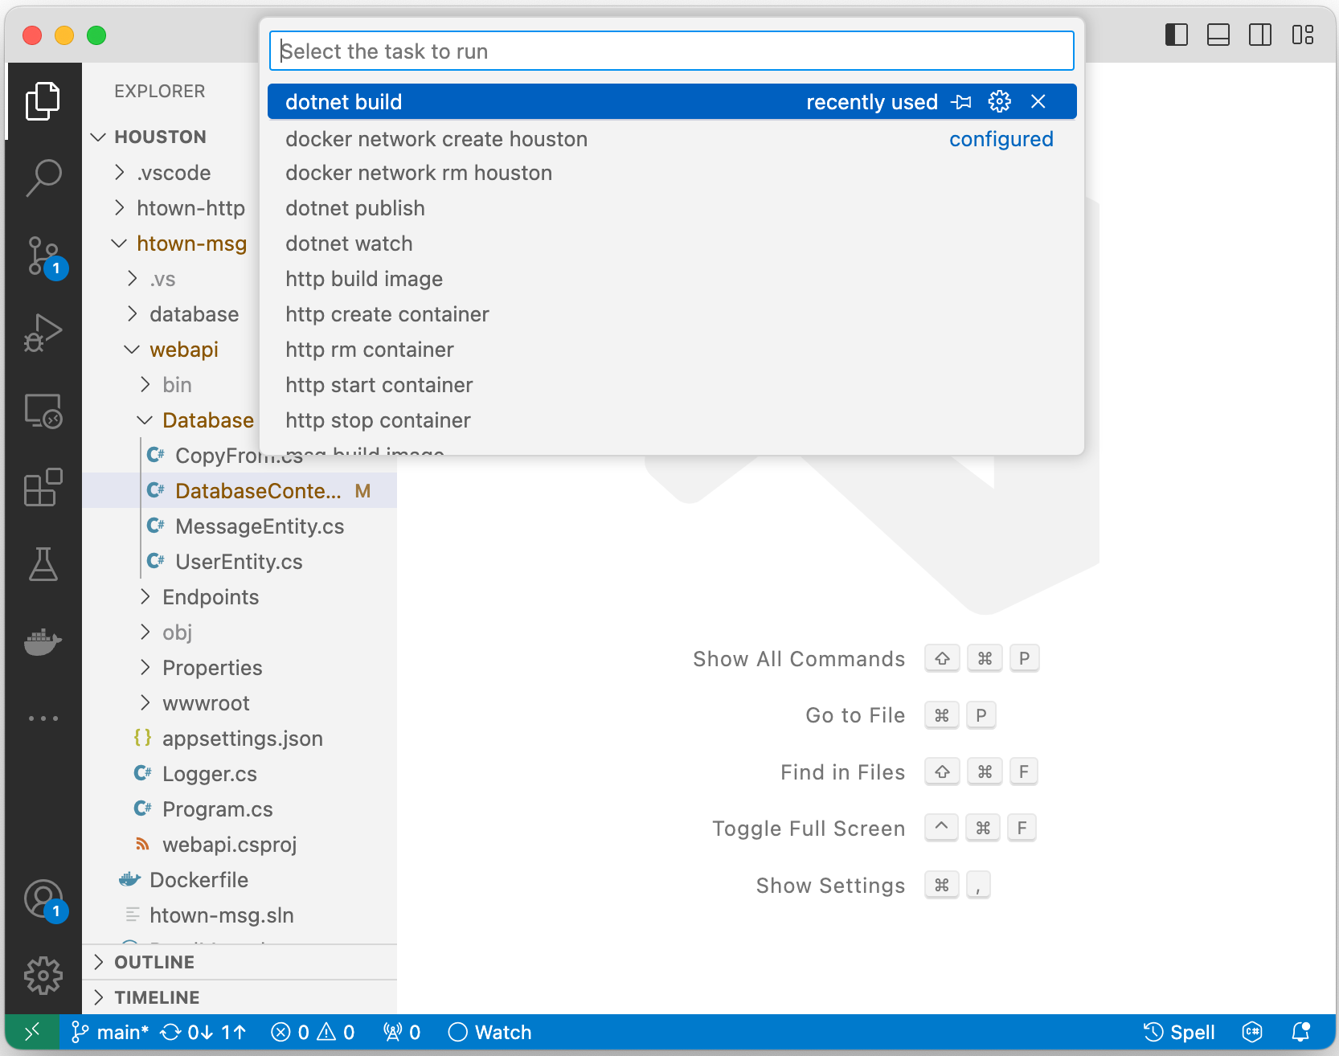
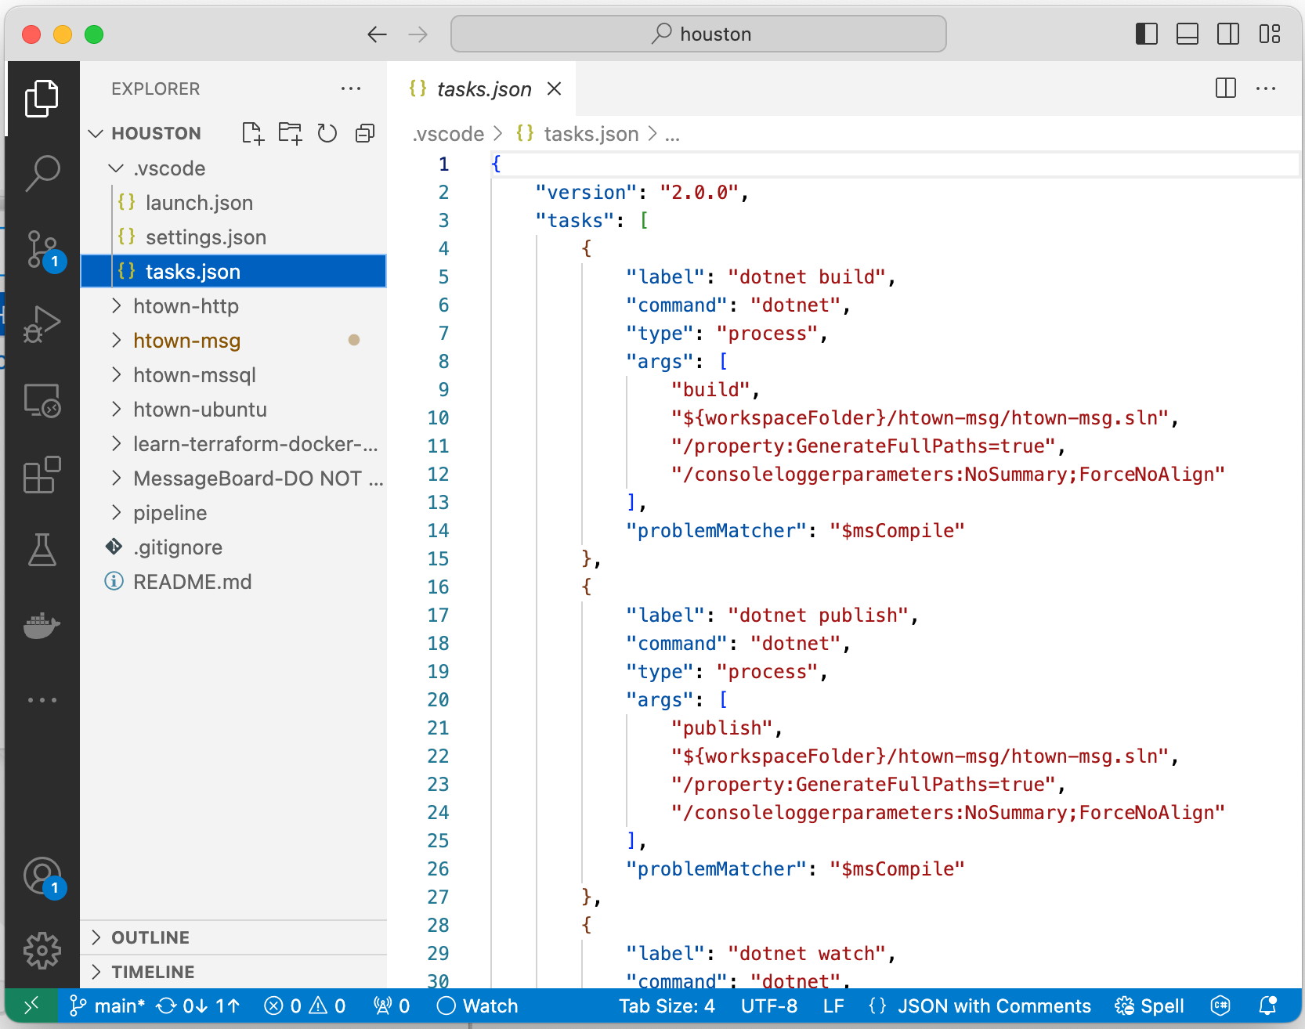
Building the Solution – VS Code
Shift – Command - T
The tasks are defined in the workspaces folder:
${workspace}\.vscode\tasks.json
Created by Shawn Zernik on 1/4/2024
Slide 53

Slide 54
Building the Solution – VS Code
Being able to do everything at the command prompt is critical – this is what you’ll need to know for setting up the pipeline.
dotnet build ${workspace}\htown-msg\htown-msg.sln
Should give the following output:
Note the artifact locations in the build output.
You can build a “csproj” or “sqlproj” directly.
Also note that a “build” will not package the “wwwroot” with the ”webapi” project. You need to “publish” for that.
Created by Shawn Zernik on 1/4/2024
Slide 54

Slide 55
Application Development with Kubernetes and AWS
Docker Containerization
Created by Shawn Zernik on 1/4/2024
Slide 55

Slide 56
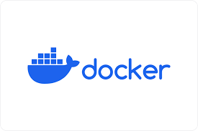
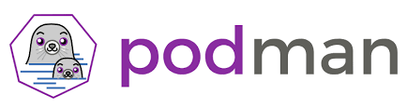
Containerization – Docker vs Podman
For getting some basic understanding of containerization, we will start simple and then get more complicated. The following folders have steps to walk through containerization.
When refering to containerization, the choice of docker or pacman is indifferent and pacman uses the same parameters and syntax a docker. Simple replace docker with pacman:
docker ps -a
pacman ps -a
(licenses required for commercial use)
(free & opensource)
Created by Shawn Zernik on 1/4/2024
Slide 56

Slide 57

Containerization – podman’s DNS Issue
Our client is using podman rather than docker. When setting podman up on the client's laptop, I was not able to pull images. This is because the WSL image used is using an invalid DNS server.
Start > Type “WSL” and click the penguin head
At the linux command prompt:
cd /etc
cat resolve.conf
Look at the “nameserver” line. If the server is invalid, you will need to edit the file and set a valid name server.
Created by Shawn Zernik on 1/4/2024
Slide 57

Slide 58
Application Development with Kubernetes and AWS
Networking
Created by Shawn Zernik on 1/4/2024
Slide 58

Slide 59
Containerization – Networking
The following is a conceptualized container runtime environment.
The key here to understand is that containers are isolated on there own network that cannot talk to your local computer.
You need to do “port forwarding” to allow access into the docket containers.
Container Runtime
Default Network
*When using a database inside a container, you need to mount persistent storage for the LDF and MDB file. Otherwise, when your container is deleted, your data is lost.
If you do not specify a network for your container, it’s added to the default.
Web Browser
Port Forwarding
8080 → 80
Houston Network
WebApi
MS SQL*
wwwroot
Persistent
Volume
SSMS
/
Azure Data Studio
Port Forwarding
1433 → 1433
Created by Shawn Zernik on 1/4/2024
Slide 59

Slide 60
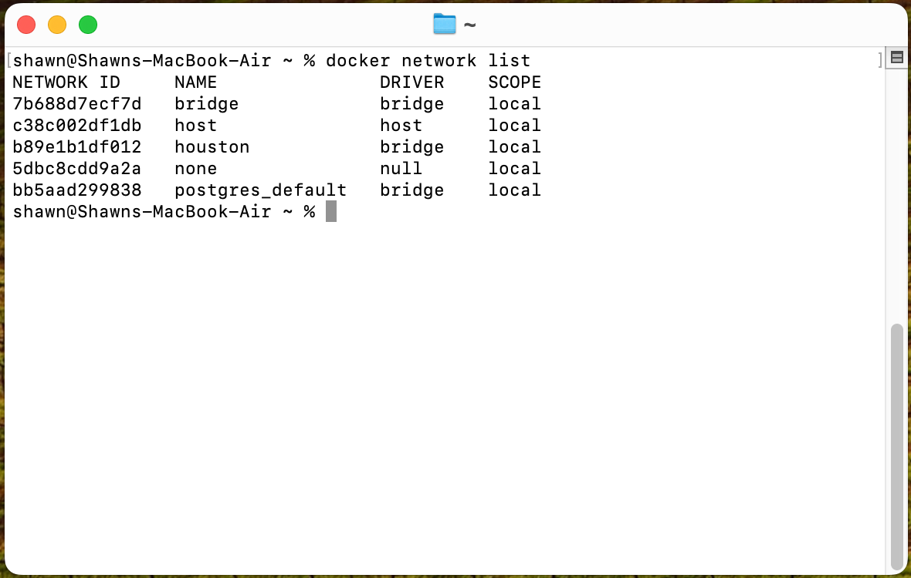
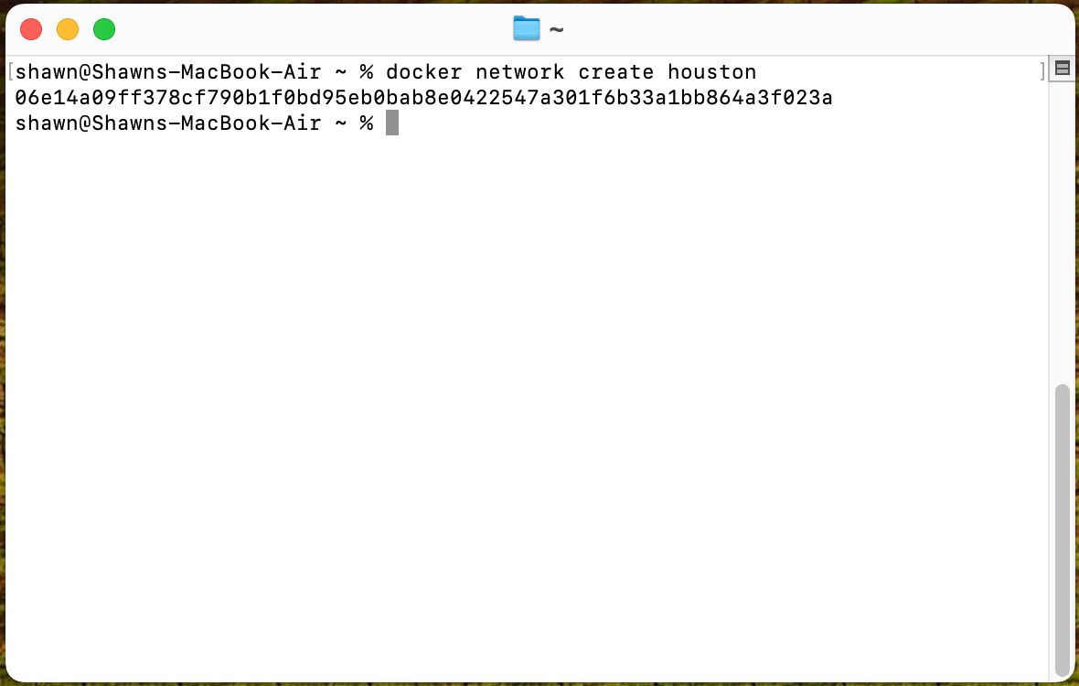
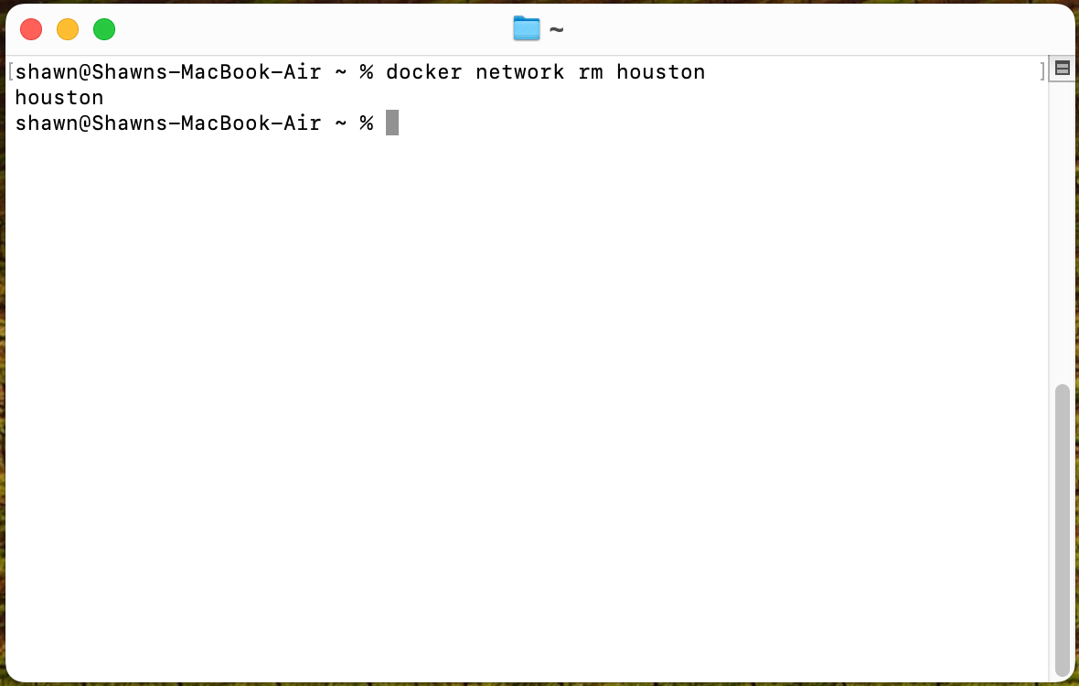
Containerization – Network Administration
For the next steps, we will explore containers and networking. First, we will discuss networking and then containers. Again, when we don’t specify a network, container engine will use the “default” network. For most instances, we will want to isolate our applications and workload on their own network.
List Network
docker network list
The network type we typically use is “bridge”. Bridge is a fancy network term for router, and for our routing, we’ll use NAT.
Create Network
docker network create houston
If we don’t specify a network type, it’ll give us a bridge. The output on success is a big long SHA hash. When referencing by hash, you must only type the first part to the point of uniqueness - otherwise you’ll target many hashes.
Delete Network
docker network rm houston
This will delete the network named “Houston”. The output on success is simply the network name.
Created by Shawn Zernik on 1/4/2024
Slide 60

Slide 61
Application Development with Kubernetes and AWS
Standard Images
Created by Shawn Zernik on 1/4/2024
Slide 61

Slide 62
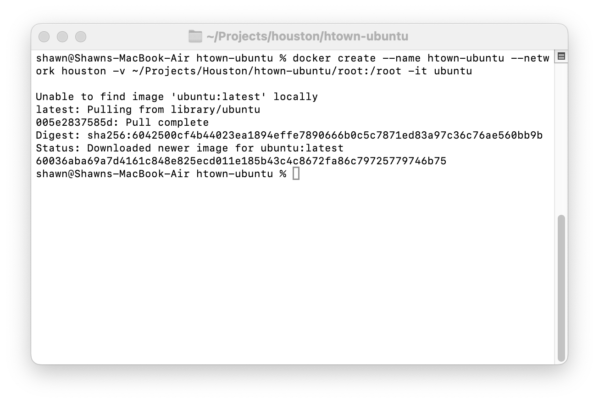
Containerization – Ubuntu Image - Create
Next, we will create an ubuntu container from the standard ubuntu image. This container will map the “/root” folder to a location on your drive.
Create Container
docker create \
--name htown-ubuntu \
--network houston \
-v ~/Projects/Houston/htown-ubuntu/root:/root \
-i \
-t \
ubuntu
Parameters
create – tells docker to create a container
--name – name of the container
--network – network to attach the image to
-v – mount local folder to a path inside of counter
-i – interactive
-t – use tty (terminal / console)
ubuntu – image to use
Created by Shawn Zernik on 1/4/2024
Slide 62

Slide 63
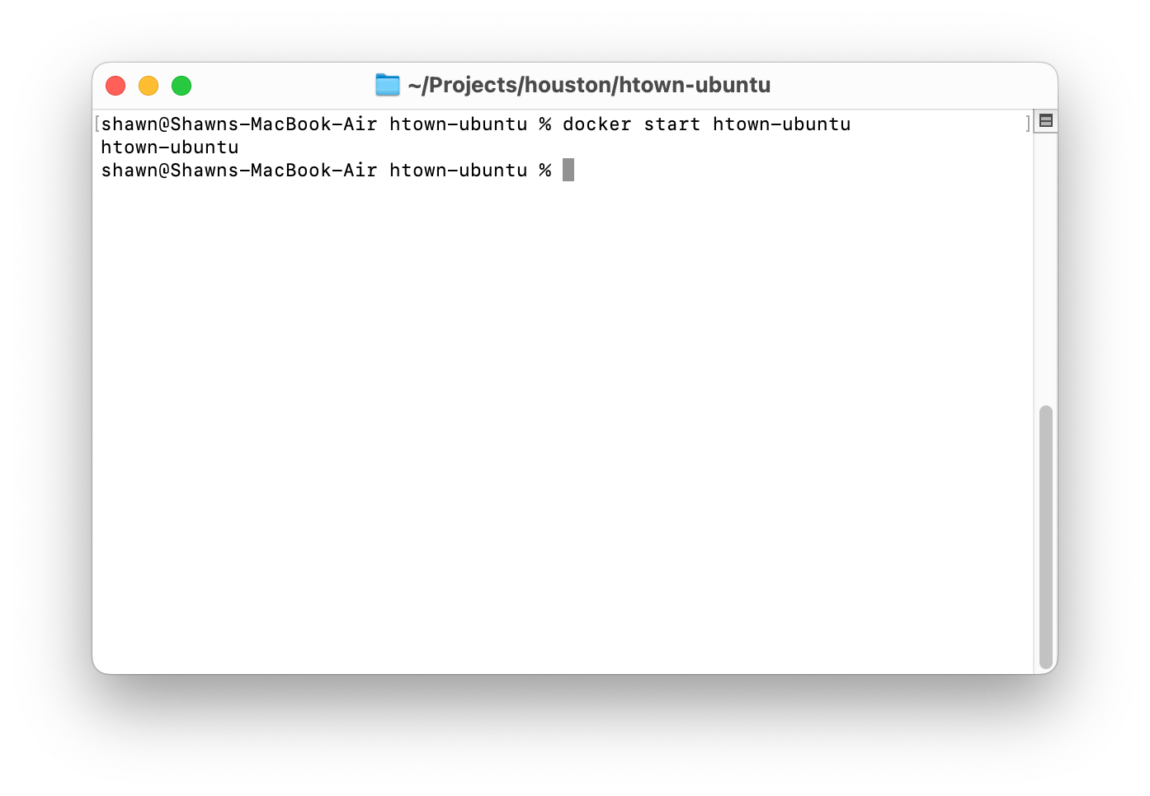
Containerization – Ubuntu Image - Start
Once we have a container, we can start it.
Start Container
docker start htown-ubuntu
Parameters
start – indicates to start a container
htown-ubuntu – name of the counter to start
On success, it lists the containers name.
Created by Shawn Zernik on 1/4/2024
Slide 63

Slide 64
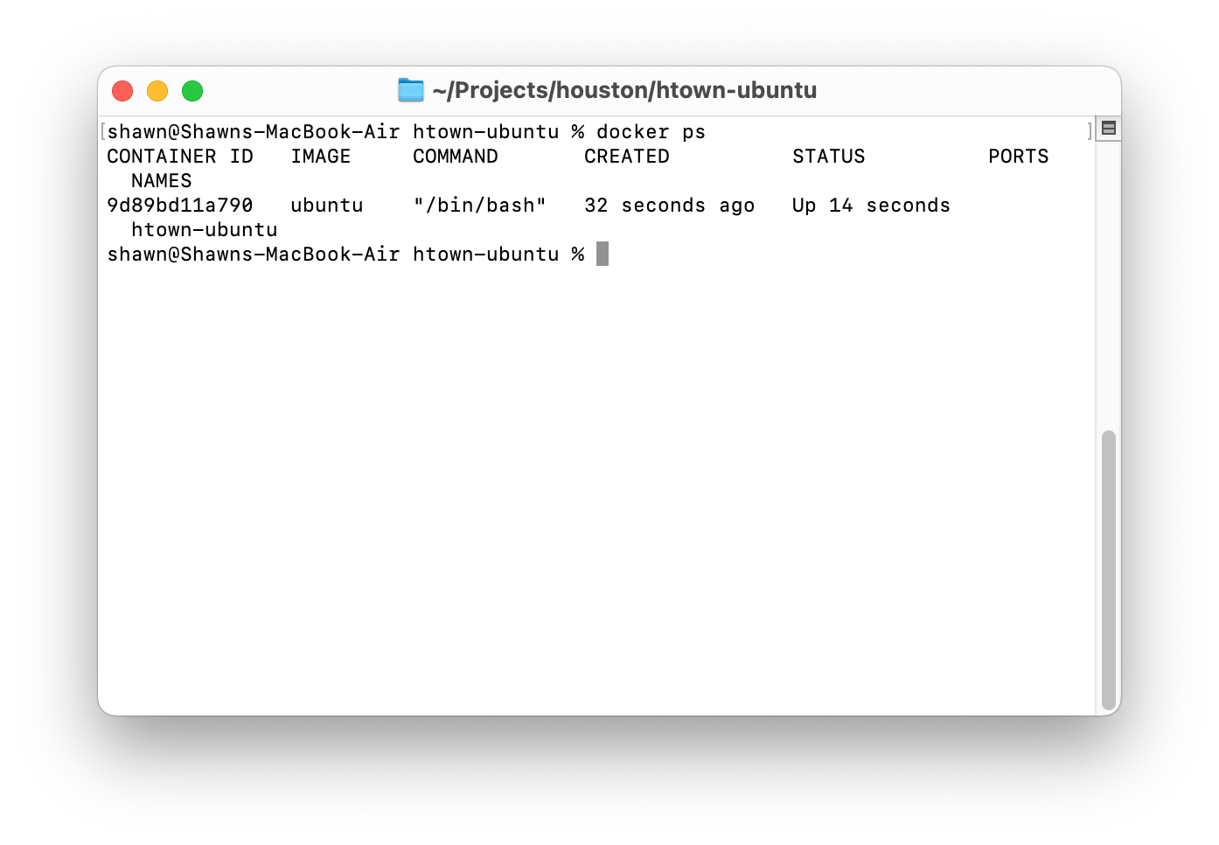
Containerization – Ubuntu Image – List Running
To see the containers running, we can use the “ps” command. Think “ps” like the linux command – it lists what’s running.
List Running Containers
docker ps
Parameters
ps – print status
Created by Shawn Zernik on 1/4/2024
Slide 64

Slide 65
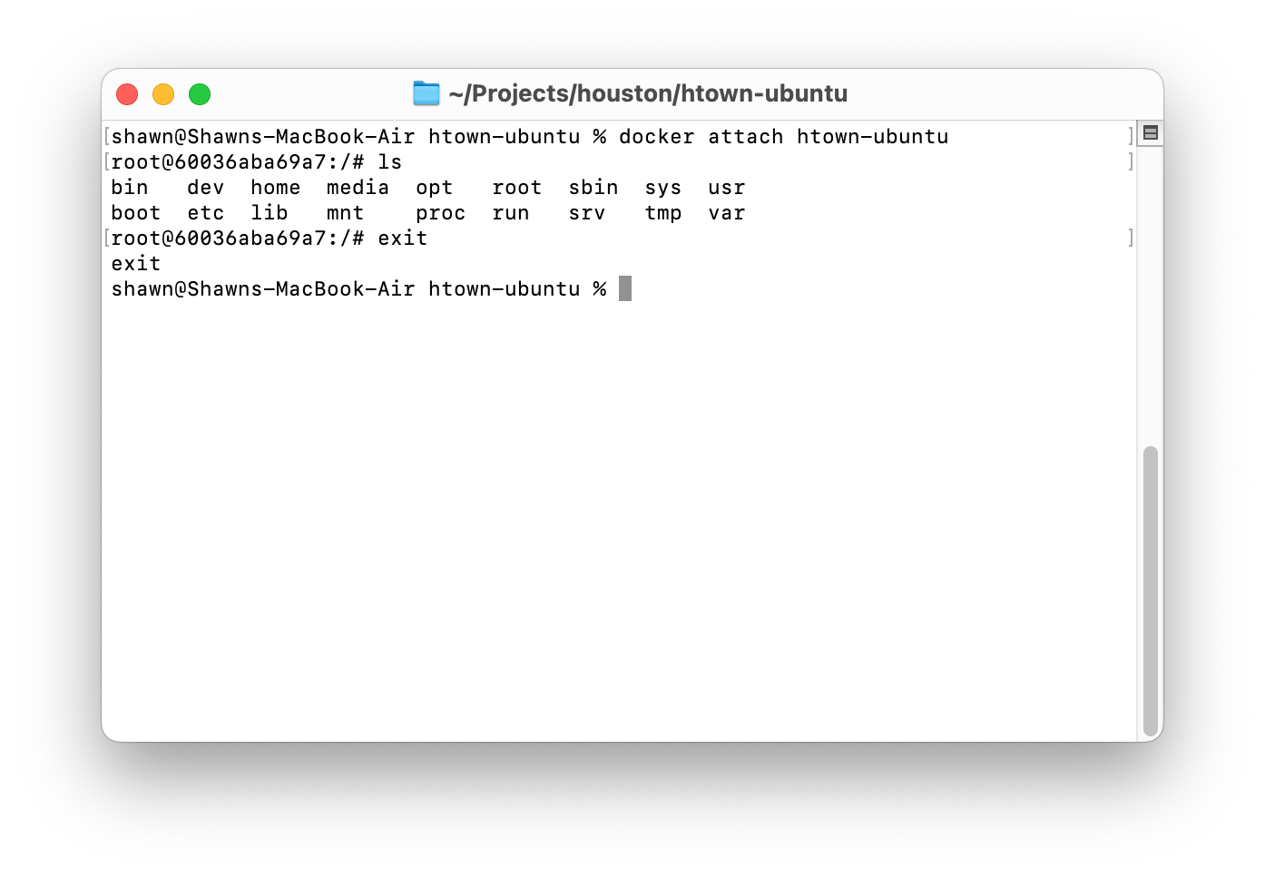
Containerization – Ubuntu Image – Connecting To
Having ubuntu running is boring. Let's connect to it and list the files then exit.
Connecting to Container
docker attach htown-ubuntu
Parameters
attach – attach std io to container
htown-ubuntu – name of container to attach to
Created by Shawn Zernik on 1/4/2024
Slide 65

Slide 66

Containerization – Ubuntu Image - Stopping
Finally, we’ll stop the container.
Stop Container
docker stop htown-ubuntu
Parameters
stop – action to perform on container
htown-ubuntu – name of container to act on
Created by Shawn Zernik on 1/4/2024
Slide 66

Slide 67
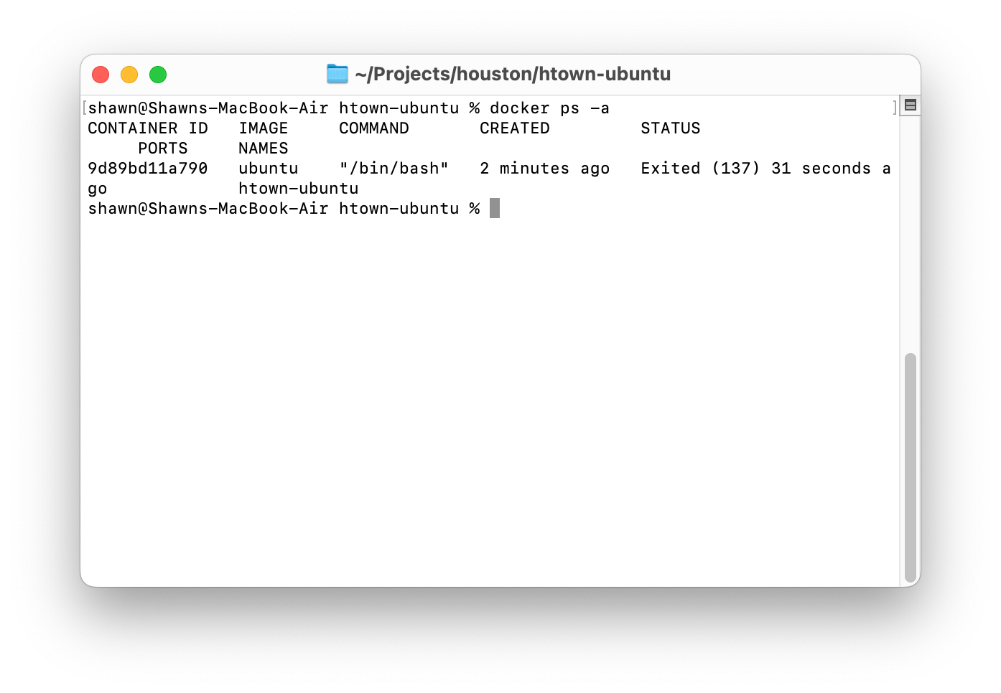
Containerization – Ubuntu Image – Listing All
Listing only the running containers gives you an incomplete view. We’ll often want to see all the containers, running or not.
List All Containers
docker ps -a
Parameters
ps – print status
-a – all, event not running
Created by Shawn Zernik on 1/4/2024
Slide 67

Slide 68

Containerization – Ubuntu Image - Deleting
When your done, delete the containers to free up space on your drive.
Delete Container
docker rm htown-ubuntu
Parameters
rm – delete action to perform on container
htown-ubuntu – name of container to act on
Created by Shawn Zernik on 1/4/2024
Slide 68

Slide 69
Containerization – Ubuntu Image – Final Note
As a final note, remember that the network your containers run in is not the same as the host operating systems. Running an ubuntu box on the same network as your containers is an awesome troubleshooting tool.
Finally, we will not list the commands to create, start, stop, delete, nor list containers in the next sections. We will focus on some specifics around the images we’ll be using.
Created by Shawn Zernik on 1/4/2024
Slide 69

Slide 70
Application Development with Kubernetes and AWS
Microsoft SQL Server
Or
Microsoft Azure SQL
Created by Shawn Zernik on 1/4/2024
Slide 70

Slide 71
Containerization – Azure SQL
This will create an instance of the Microsoft Azure SQL Edge server. Effectively, this is the Azure SQL server used in Microsoft’s cloud.
Microsoft Azure SQL
Running Microsoft SQL server on ARM processors gives a nice error. An alternative is to run the Microsoft Azure SQL. The command to create the container is as follows:
docker create \
-e "ACCEPT_EULA=Y" \
-e "MSSQL_SA_PASSWORD=Welcome123" \
-v "~/Projects/houston/htown-mssql/data":/var/opt/mssql/data \
-v "~/Projects/houston/htown-mssql/log":/var/opt/mssql/log \
-p 1433:1433 \
--network houston \
--name htown-mssql \
mcr.microsoft.com/azure-sql-edge
Parameters
-e – sets environment variables
ACCEPT_EULA – accepts the license agreement
MSSQL_SA_PASSWORD – set the password for the “sa” (admin) account
-p outside_port:inside_port – defines the port fordwarding rule to allow traffic from the “outside_port” into the containers “inside_port”.
Data Persistence
Stateful containers must have special care taken that the state is stored in/on some type of persistent storage.
Orchestration systems typically delete containers - so any data inside the container will be lost.
https://hub.docker.com/_/microsoft-azure-sql-edge
Created by Shawn Zernik on 1/4/2024
Slide 71

Slide 72
Containerization – Azure SQL
For a traditional Microsoft SQL server, we can use the follow. Note– this will not work on Mac’s with ARM processors.
Microsoft Azure SQL
Running Microsoft SQL server on ARM processors gives a nice error. An alternative is to run the Microsoft Azure SQL. The command to create the container is as follows:
docker create \
-e "ACCEPT_EULA=Y" \
-e "MSSQL_SA_PASSWORD=Welcome123" \
-e "MSSQL_PID=Developer"
-v "~/Projects/houston/htown-mssql/data":/var/opt/mssql/data \
-v "~/Projects/houston/htown-mssql/log":/var/opt/mssql/log \
-p 1433:1433 \
--network houston \
--name htown-mssql \
mcr.microsoft.com/mssql/server:2022-latest
Parameters
-e – sets environment variables
ACCEPT_EULA – accepts the license agreement
MSSQL_SA_PASSWORD – set the password for the “sa” (admin) account
MSSQL_PID – the flavor of SQL server
Developer
Express
Standard
Enterprise
EnterpriseCore
-p outside_port:inside_port – defines the port fordwarding rule to allow traffic from the “outside_port” into the containers “inside_port”.
Data Persistence
Stateful containers must have special care taken that the state is stored in/on some type of persistent storage.
Orchestration systems typically delete containers - so any data inside the container will be lost.
https://learn.microsoft.com/en-us/sql/linux/sql-server-linux-configure-environment-variables?view=sql-server-2017
Created by Shawn Zernik on 1/4/2024
Slide 72

Slide 73
Containerization – Developers
Postgres SQL https://hub.docker.com/_/postgres
MySQL https://hub.docker.com/_/mysql
MariaDB https://hub.docker.com/_/mariadb
Mongo https://hub.docker.com/_/mongo
RabbitMQ https://hub.docker.com/_/rabbitmq
Redis https://hub.docker.com/_/redis
DB2 https://hub.docker.com/r/ibmcom/db2
OracleDB https://github.com/oracle/docker-images/tree/main/OracleDatabase/SingleInstance
SonarQube https://hub.docker.com/_/sonarqube
Note to Developers
Rather than install database servers directly on your operating system, use containers. They install faster, start faster, use less space, and do not run 100% of the time – only when you start them. Practice with containers this way!
Created by Shawn Zernik on 1/4/2024
Slide 73

Slide 74
Application Development with Kubernetes and AWS
Custom Images
Created by Shawn Zernik on 1/4/2024
Slide 74

Slide 75
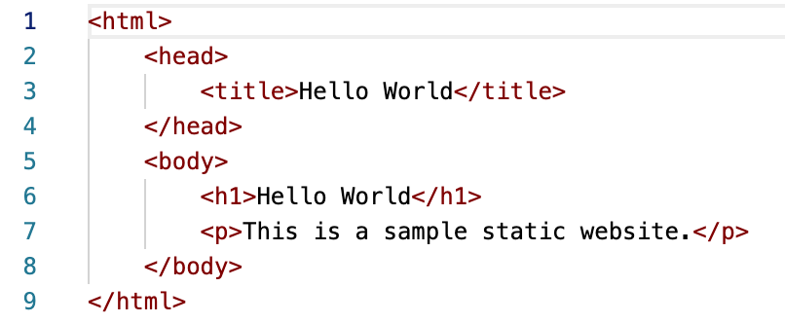
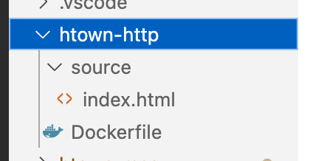
Containerization – Custom Images – Files Used
We’ll need to create a custom image to deploy our application – stock images will only get you so far. Being able to inject software, data, and content into images is critical for custom software. For demonstration purposes, we’ll create a ”hello world” website.
Created by Shawn Zernik on 1/4/2024
Slide 75

Slide 76
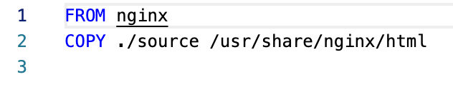
Containerization – Custom Images – Dockerfile
It does not get much simpler than this. We are starting with “nginx” image – a web server / proxy server. We will then copy “index.html” into the root of the website.
Created by Shawn Zernik on 1/4/2024
Slide 76

Slide 77
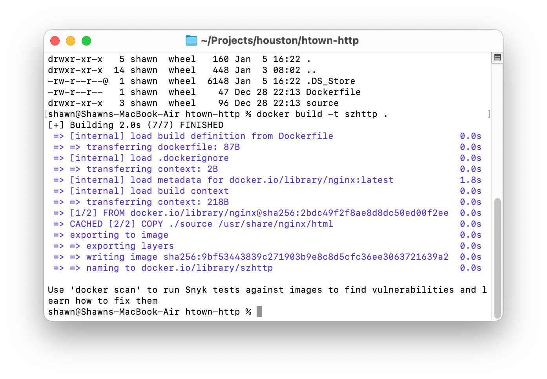
Containerization – Custom Images - Building
Now we need to build the container. When executing the “docker build” command, we need to have the current directory be the same location that has our ”Dockerfile”. In my instance, that’s “~/Projects/houston/htown-http”.
Build an Image
docker build –t szhttp .
Parameters
build – the action to take
-t – the “name:tage” to tag the image
. – the path to work from
Note the final dot on the command – this represents the current directory.
As another note, containers look for the file named “Dockerfile”. It has to be this name.
Output will list the images it downloaded, and actions taken. Once completed, you can create a container.
Created by Shawn Zernik on 1/4/2024
Slide 77

Slide 78
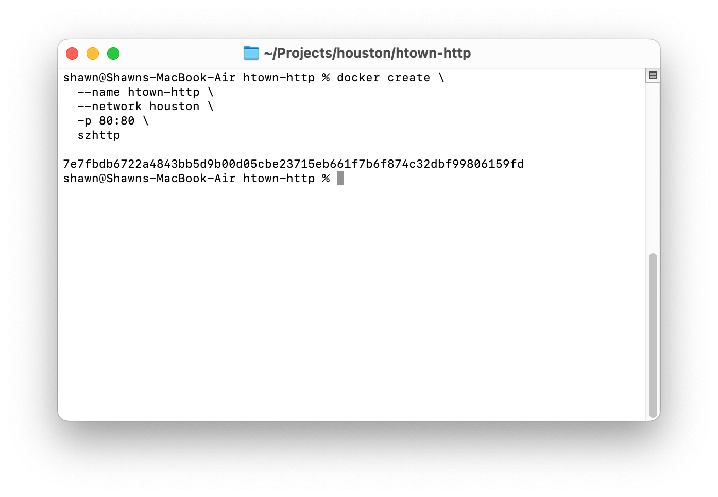
Containerization – Custom Images – Creating the Container
Now we need to build the container. When executing the “docker build” command, we need to have the current directory be the same location that has our ”Dockerfile”. In my instance, that’s “~/Projects/houston/htown-http”.
Create Container
docker create \
--name htown-http \
--network houston \
-p 80:80 \
szhttp
Parameters
In the prior “create container” we explained all the parameters used here.
Created by Shawn Zernik on 1/4/2024
Slide 78

Slide 79
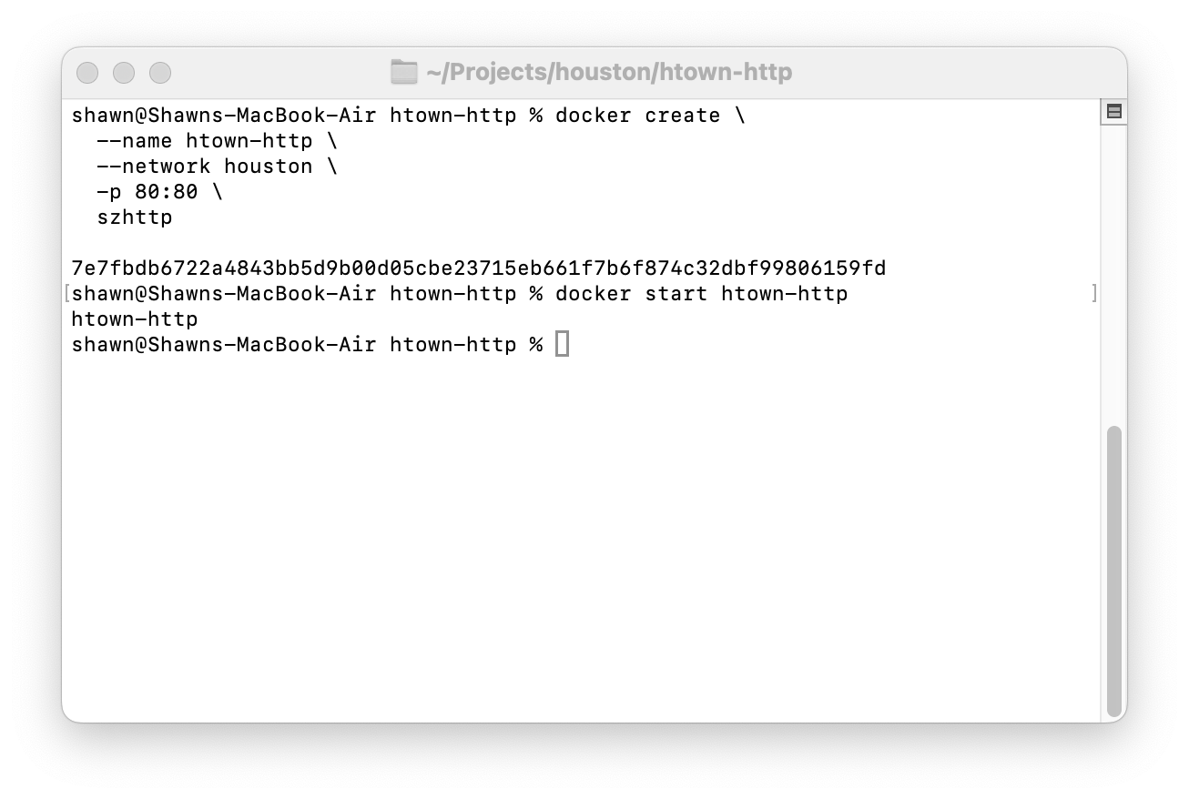
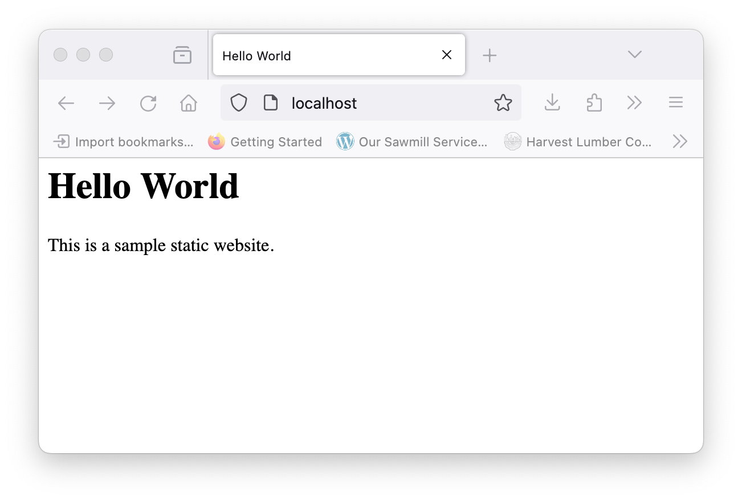
Containerization – Custom Images – Run and Test
Next we will need to start our container: “docker start htown-http”. We can then open our web browser the use the following URL: “http://localhost” and should see the web page.
Created by Shawn Zernik on 1/4/2024
Slide 79

Slide 80
Application Development with Kubernetes and AWS
Deploying DACPACs
Created by Shawn Zernik on 1/4/2024
Slide 80

Slide 81
Deploying DACPACs
Now that we have a Microsoft SQL Server or Azure SQL Server, we can deploy our DACPAC to the database server.
Make sure you have your database server running. Connect your database client:
SQL Server Management Studio – Windows Only https://learn.microsoft.com/en-us/sql/ssms/download-sql-server-management-studio-ssms?view=sql-server-ver16
Azure Data Studio https://azure.microsoft.com/en-us/products/data-studio
Dbeaver https://dbeaver.io/
Created by Shawn Zernik on 1/4/2024
Slide 81

Slide 82
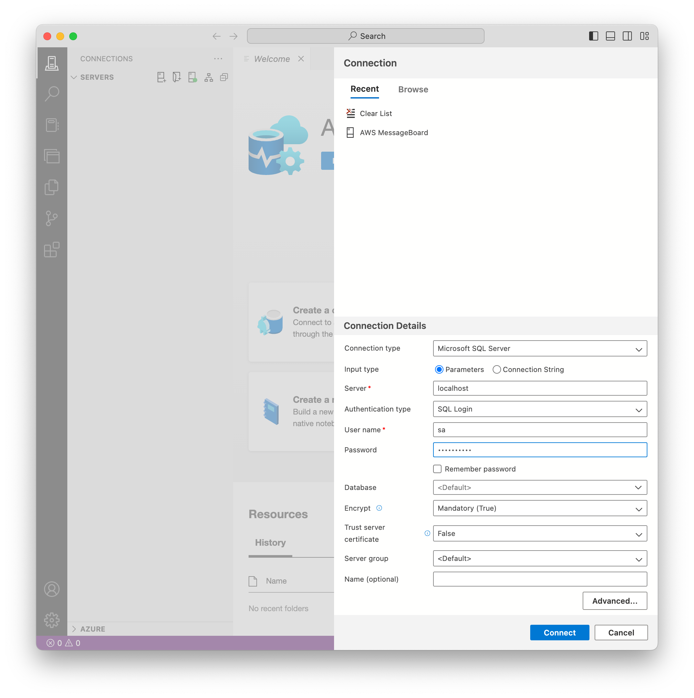
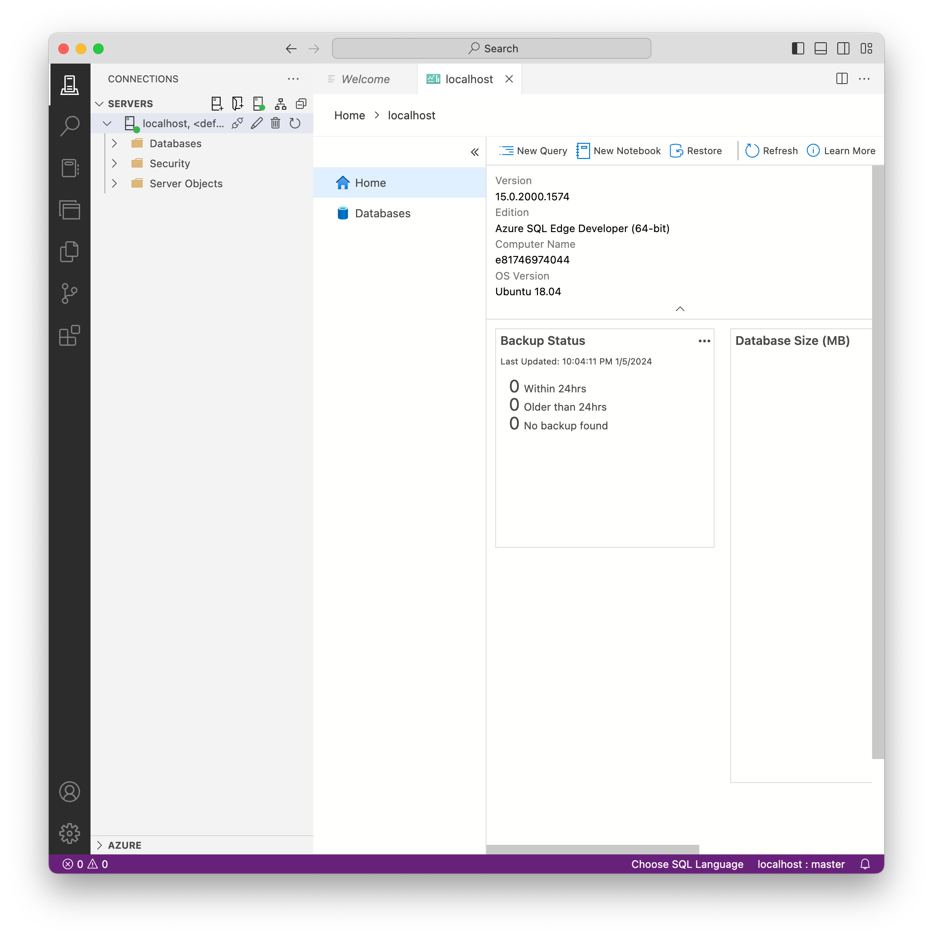
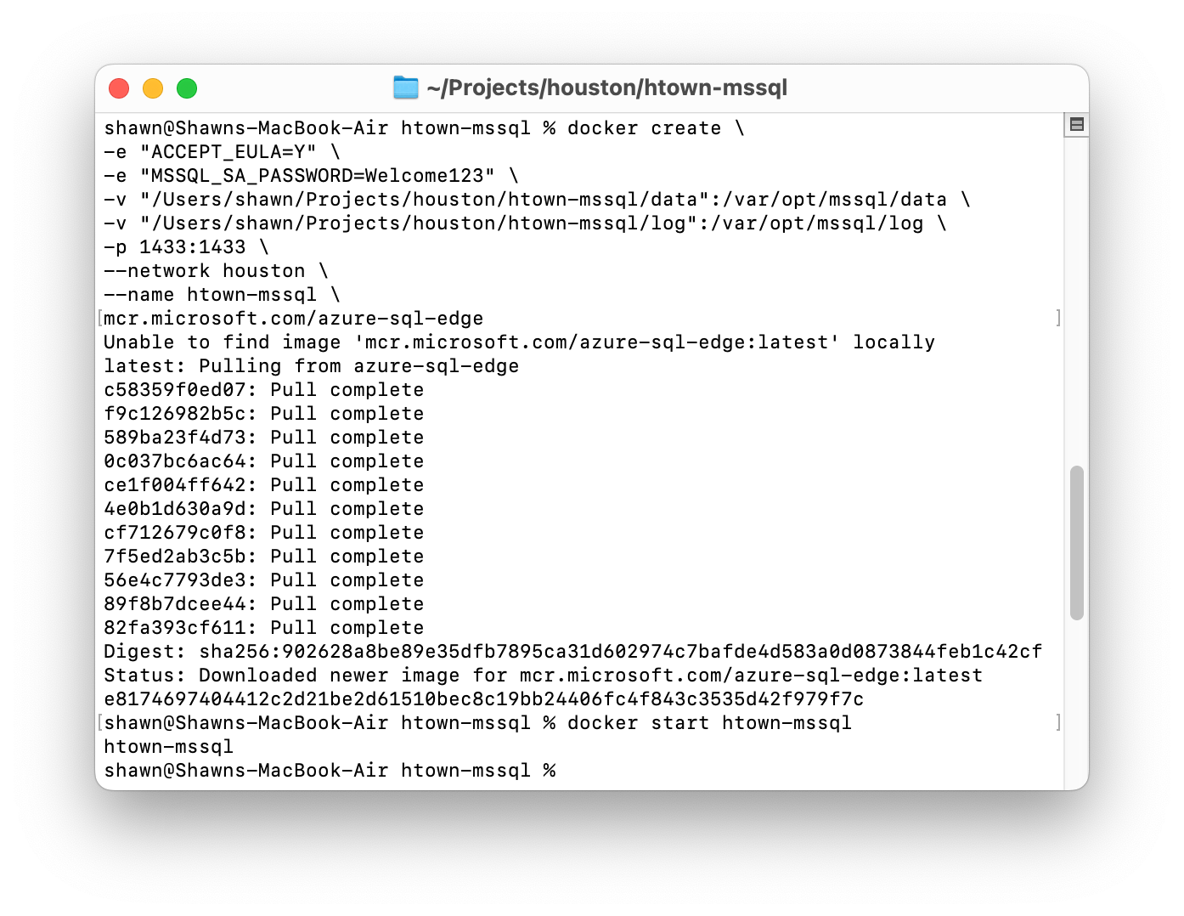
Deploying DACPACs – Validating Database Connectivity
From left to right, we created our SQL server, started it. I then opened Azure Data Studio and put in the connection details and clicked connect. It asked me to trust the server's certificate. Finally, I’m connected. We are ready to deploy the DACPAC now that I’ve verified database connectivity.
2
1
3
4
Created by Shawn Zernik on 1/4/2024
Slide 82

Slide 83
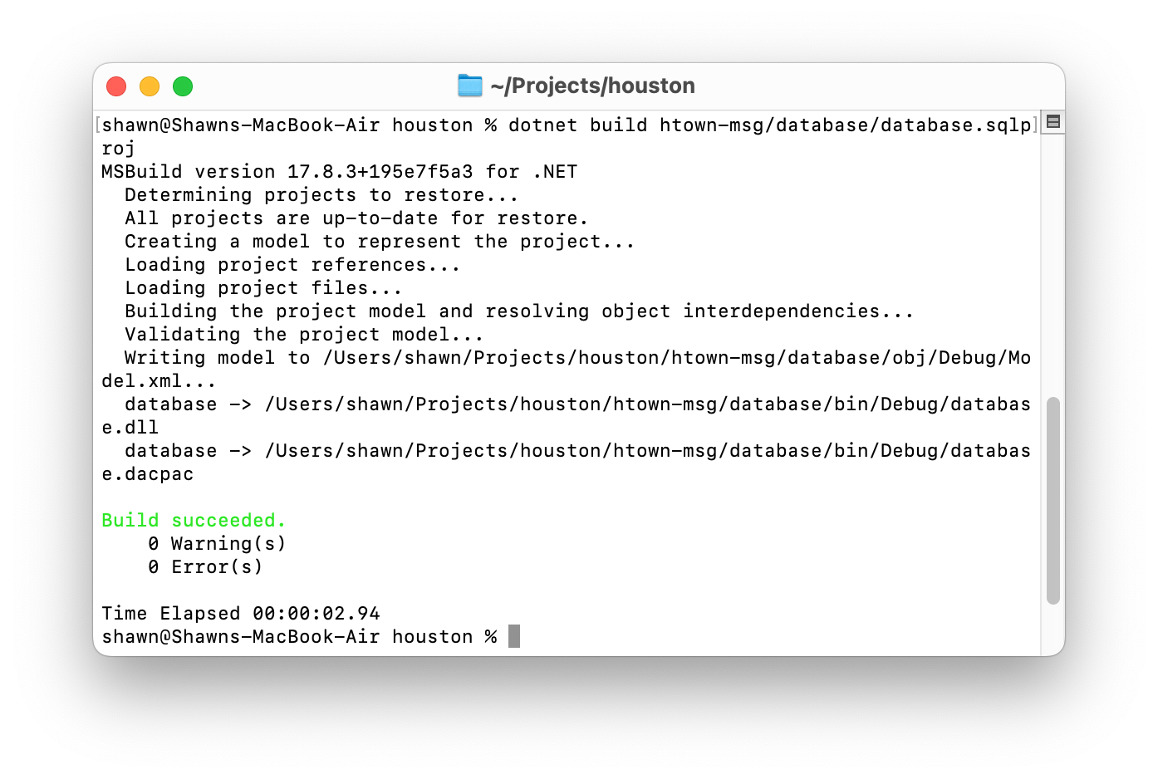
Deploying DACPACs – Build the DACPAC
Next, we’ll build our DACPAC from the DacFx project:
dotnet build htown-msg/database/database.sqlproj
Created by Shawn Zernik on 1/4/2024
Slide 83

Slide 84
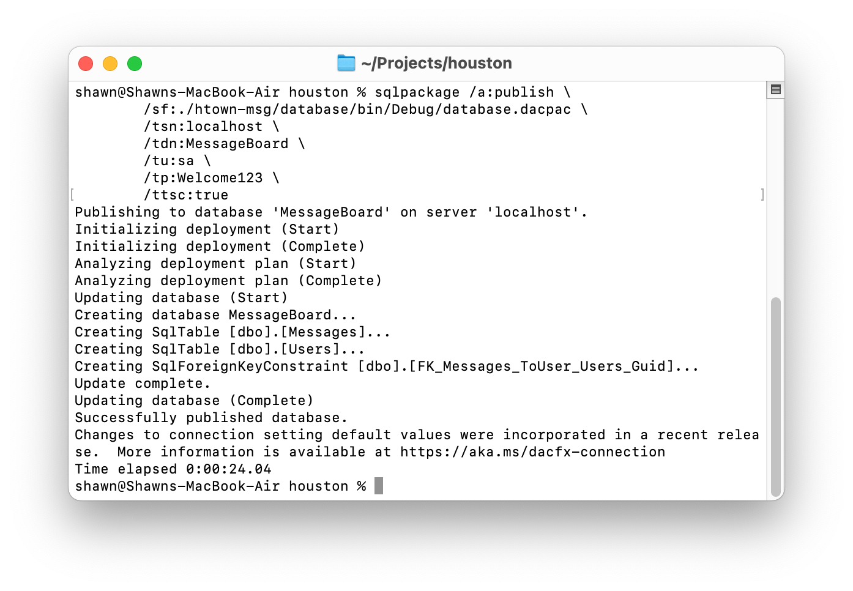
Deploying DACPACs – Publish DACPAC
Now we will publish the DACPAC to our database server:
sqlpackage \
/a:publish \
/sf:./htown-msg/database/bin/Debug/database.dacpac \
/tsn:localhost \
/tdn:MessageBoard \
/tu:sa \
/tp:Welcome123 \
/ttsc:true
Created by Shawn Zernik on 1/4/2024
Slide 84

Slide 85
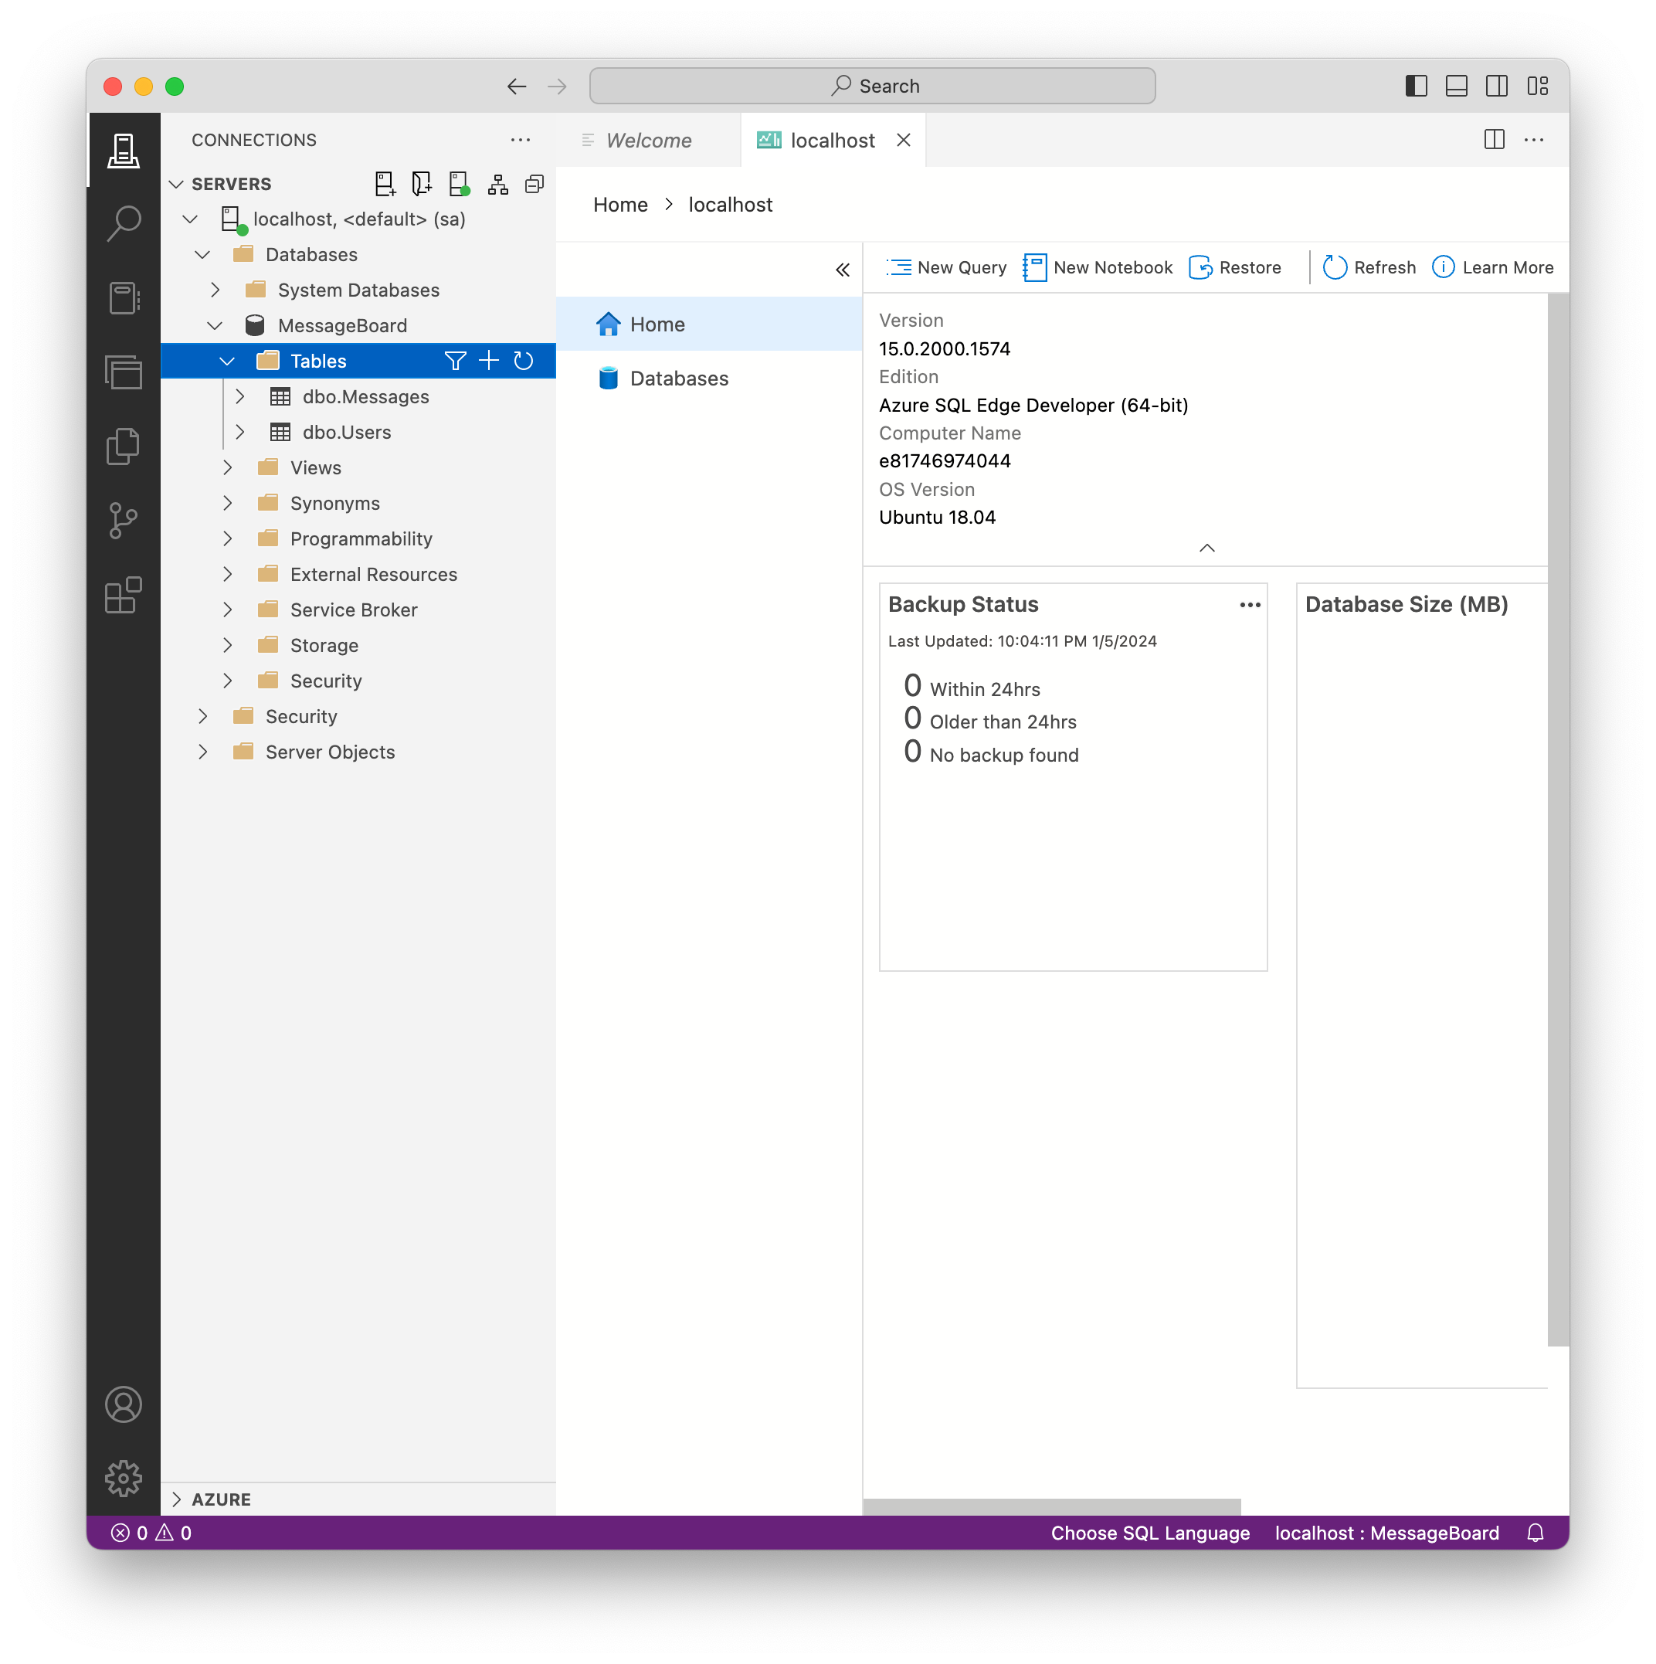
Deploying DACPACs – Validate Published
Finally, we’ll use our SQL client to validate the database and tables were created:
ALL GOOD!
Created by Shawn Zernik on 1/4/2024
Slide 85

Slide 86
Application Development with Kubernetes and AWS
Running Houston Message Board
Created by Shawn Zernik on 1/4/2024
Slide 86

Slide 87
Running Houston Message Board
Now that we have a database up validated, we can run Houston Message Board. We can do this one of two ways:
Thought VS Code and Debug Having an environment that you can locally run the code and debug is critical.
Through the Command Line Building and running an application on the command line is the next critical step to containerize. We need to know all the command and inputs to build our container.
Created by Shawn Zernik on 1/4/2024
Slide 87

Slide 88
Application Development with Kubernetes and AWS
1) Debugging in VS Code
Created by Shawn Zernik on 1/4/2024
Slide 88

Slide 89
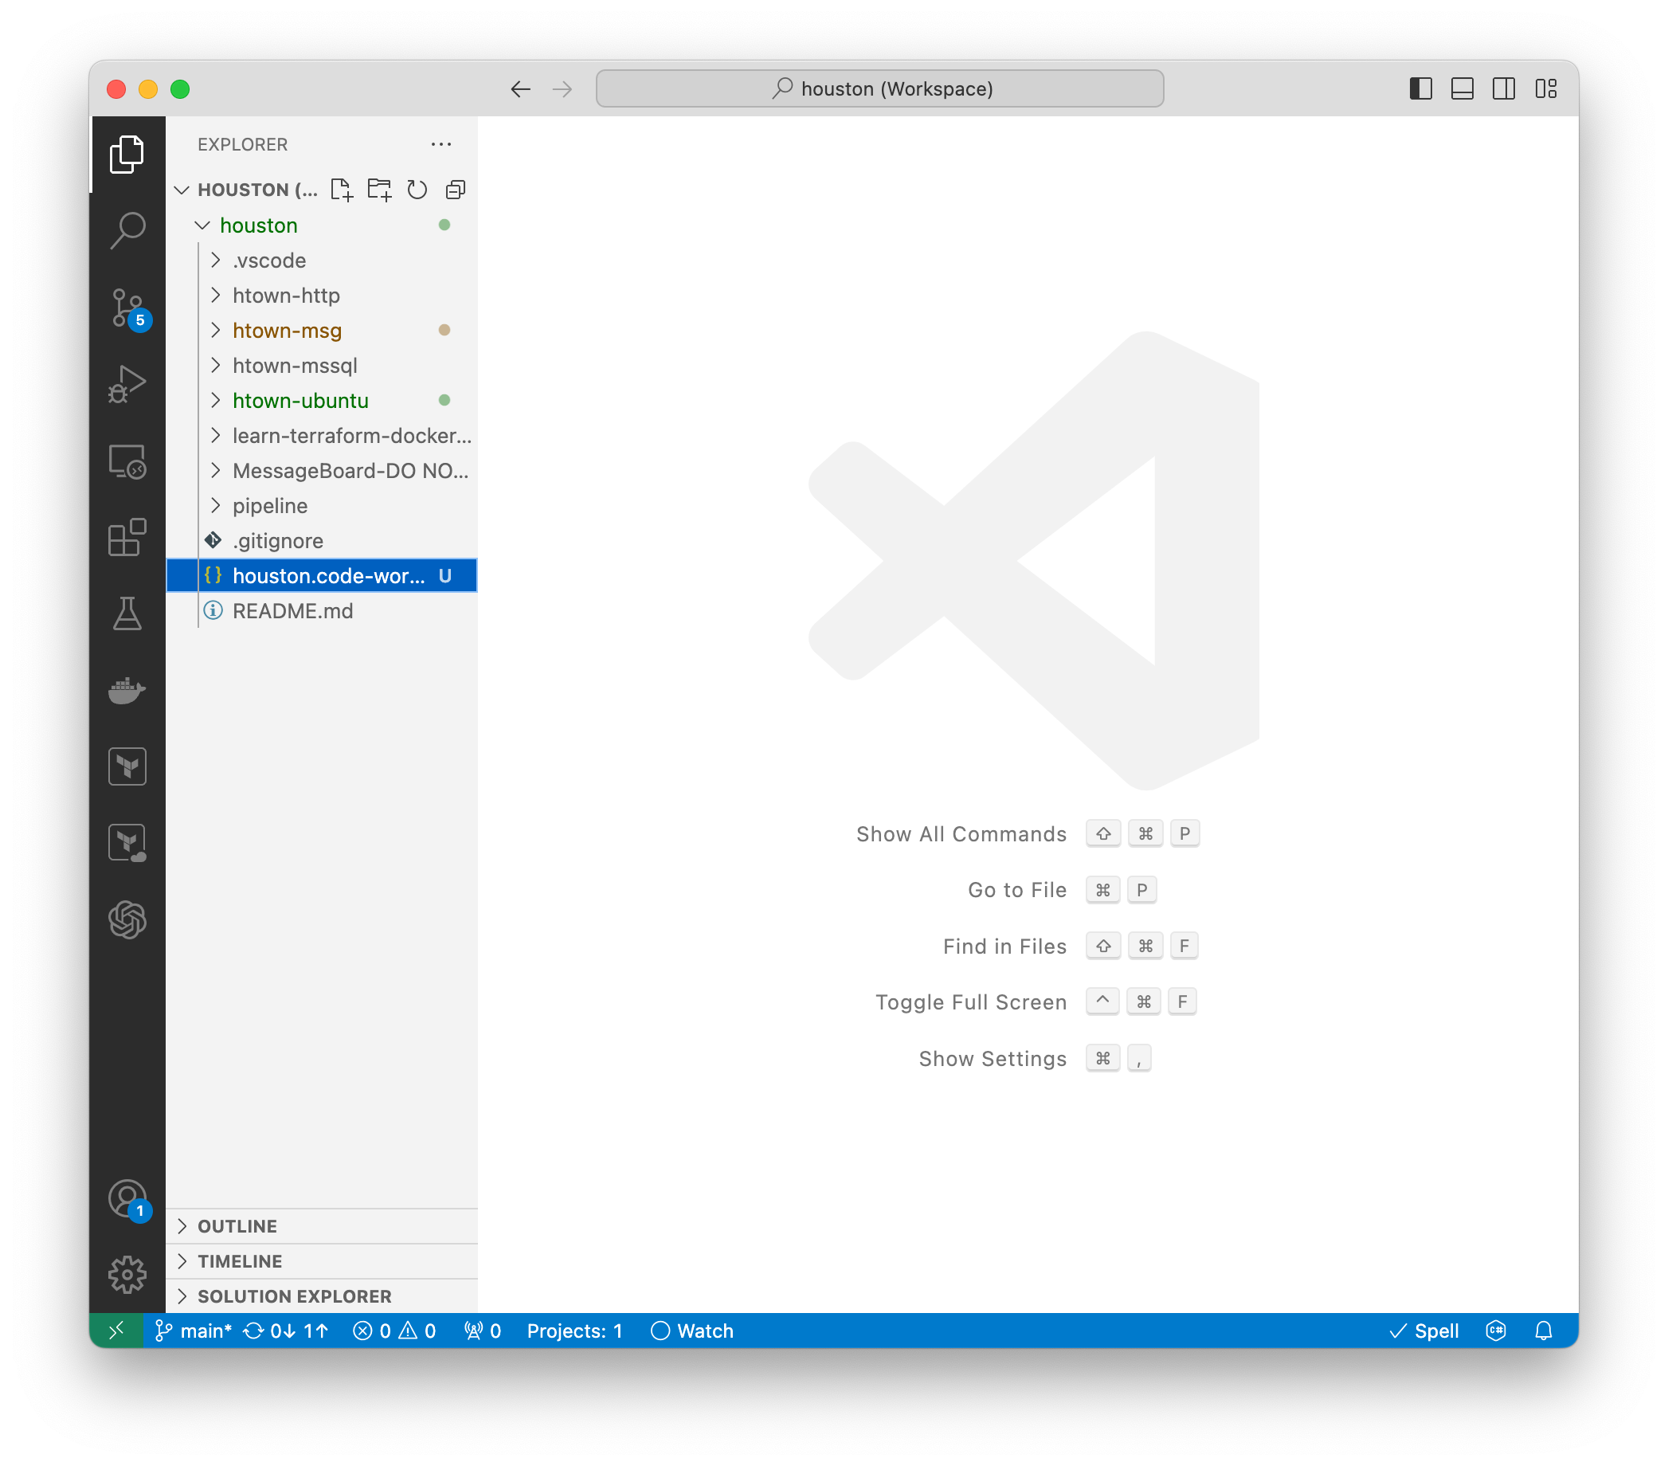
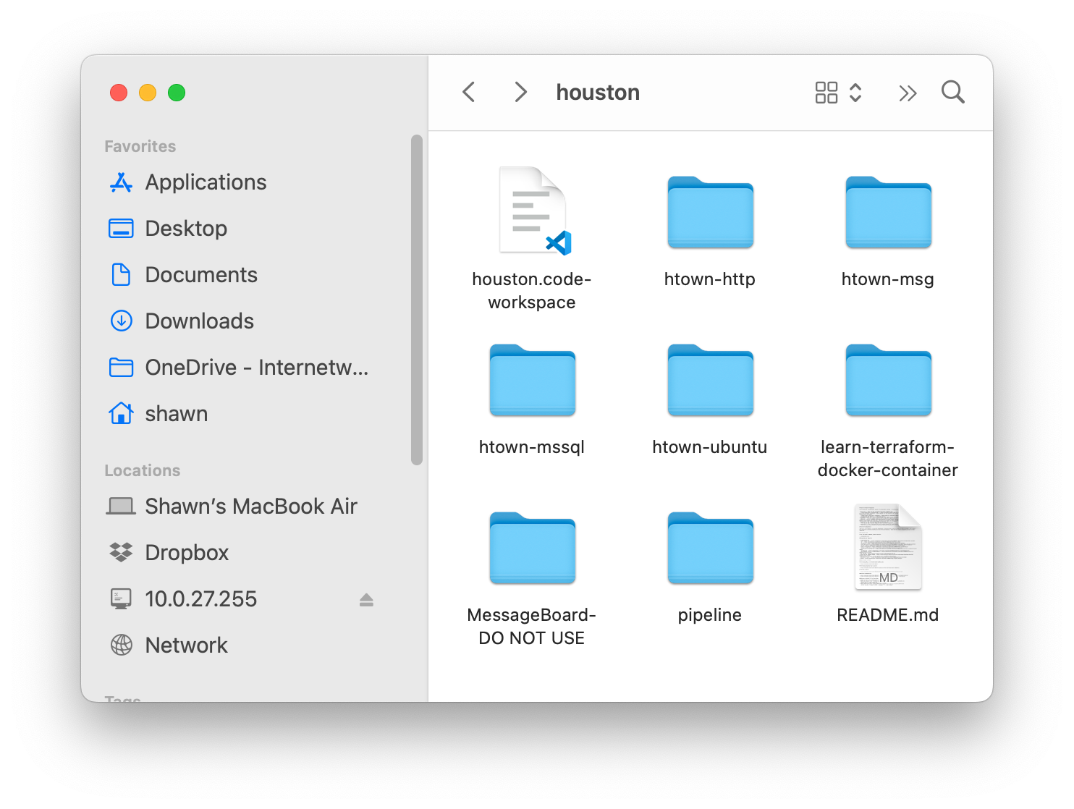
Running Houston Message Board – VS Code – Workspace
In the repository root, there is a “houston.code-workspace” file. Use this to open Visual Studio Code.
Always use a workspace file. When making changes to your IDE, coding styles, capitalization, lint settings, etc, you have the option to save these setting in the workspace file: do so. That way everyone on the team can operate on the same settings.
Created by Shawn Zernik on 1/4/2024
Slide 89

Slide 90
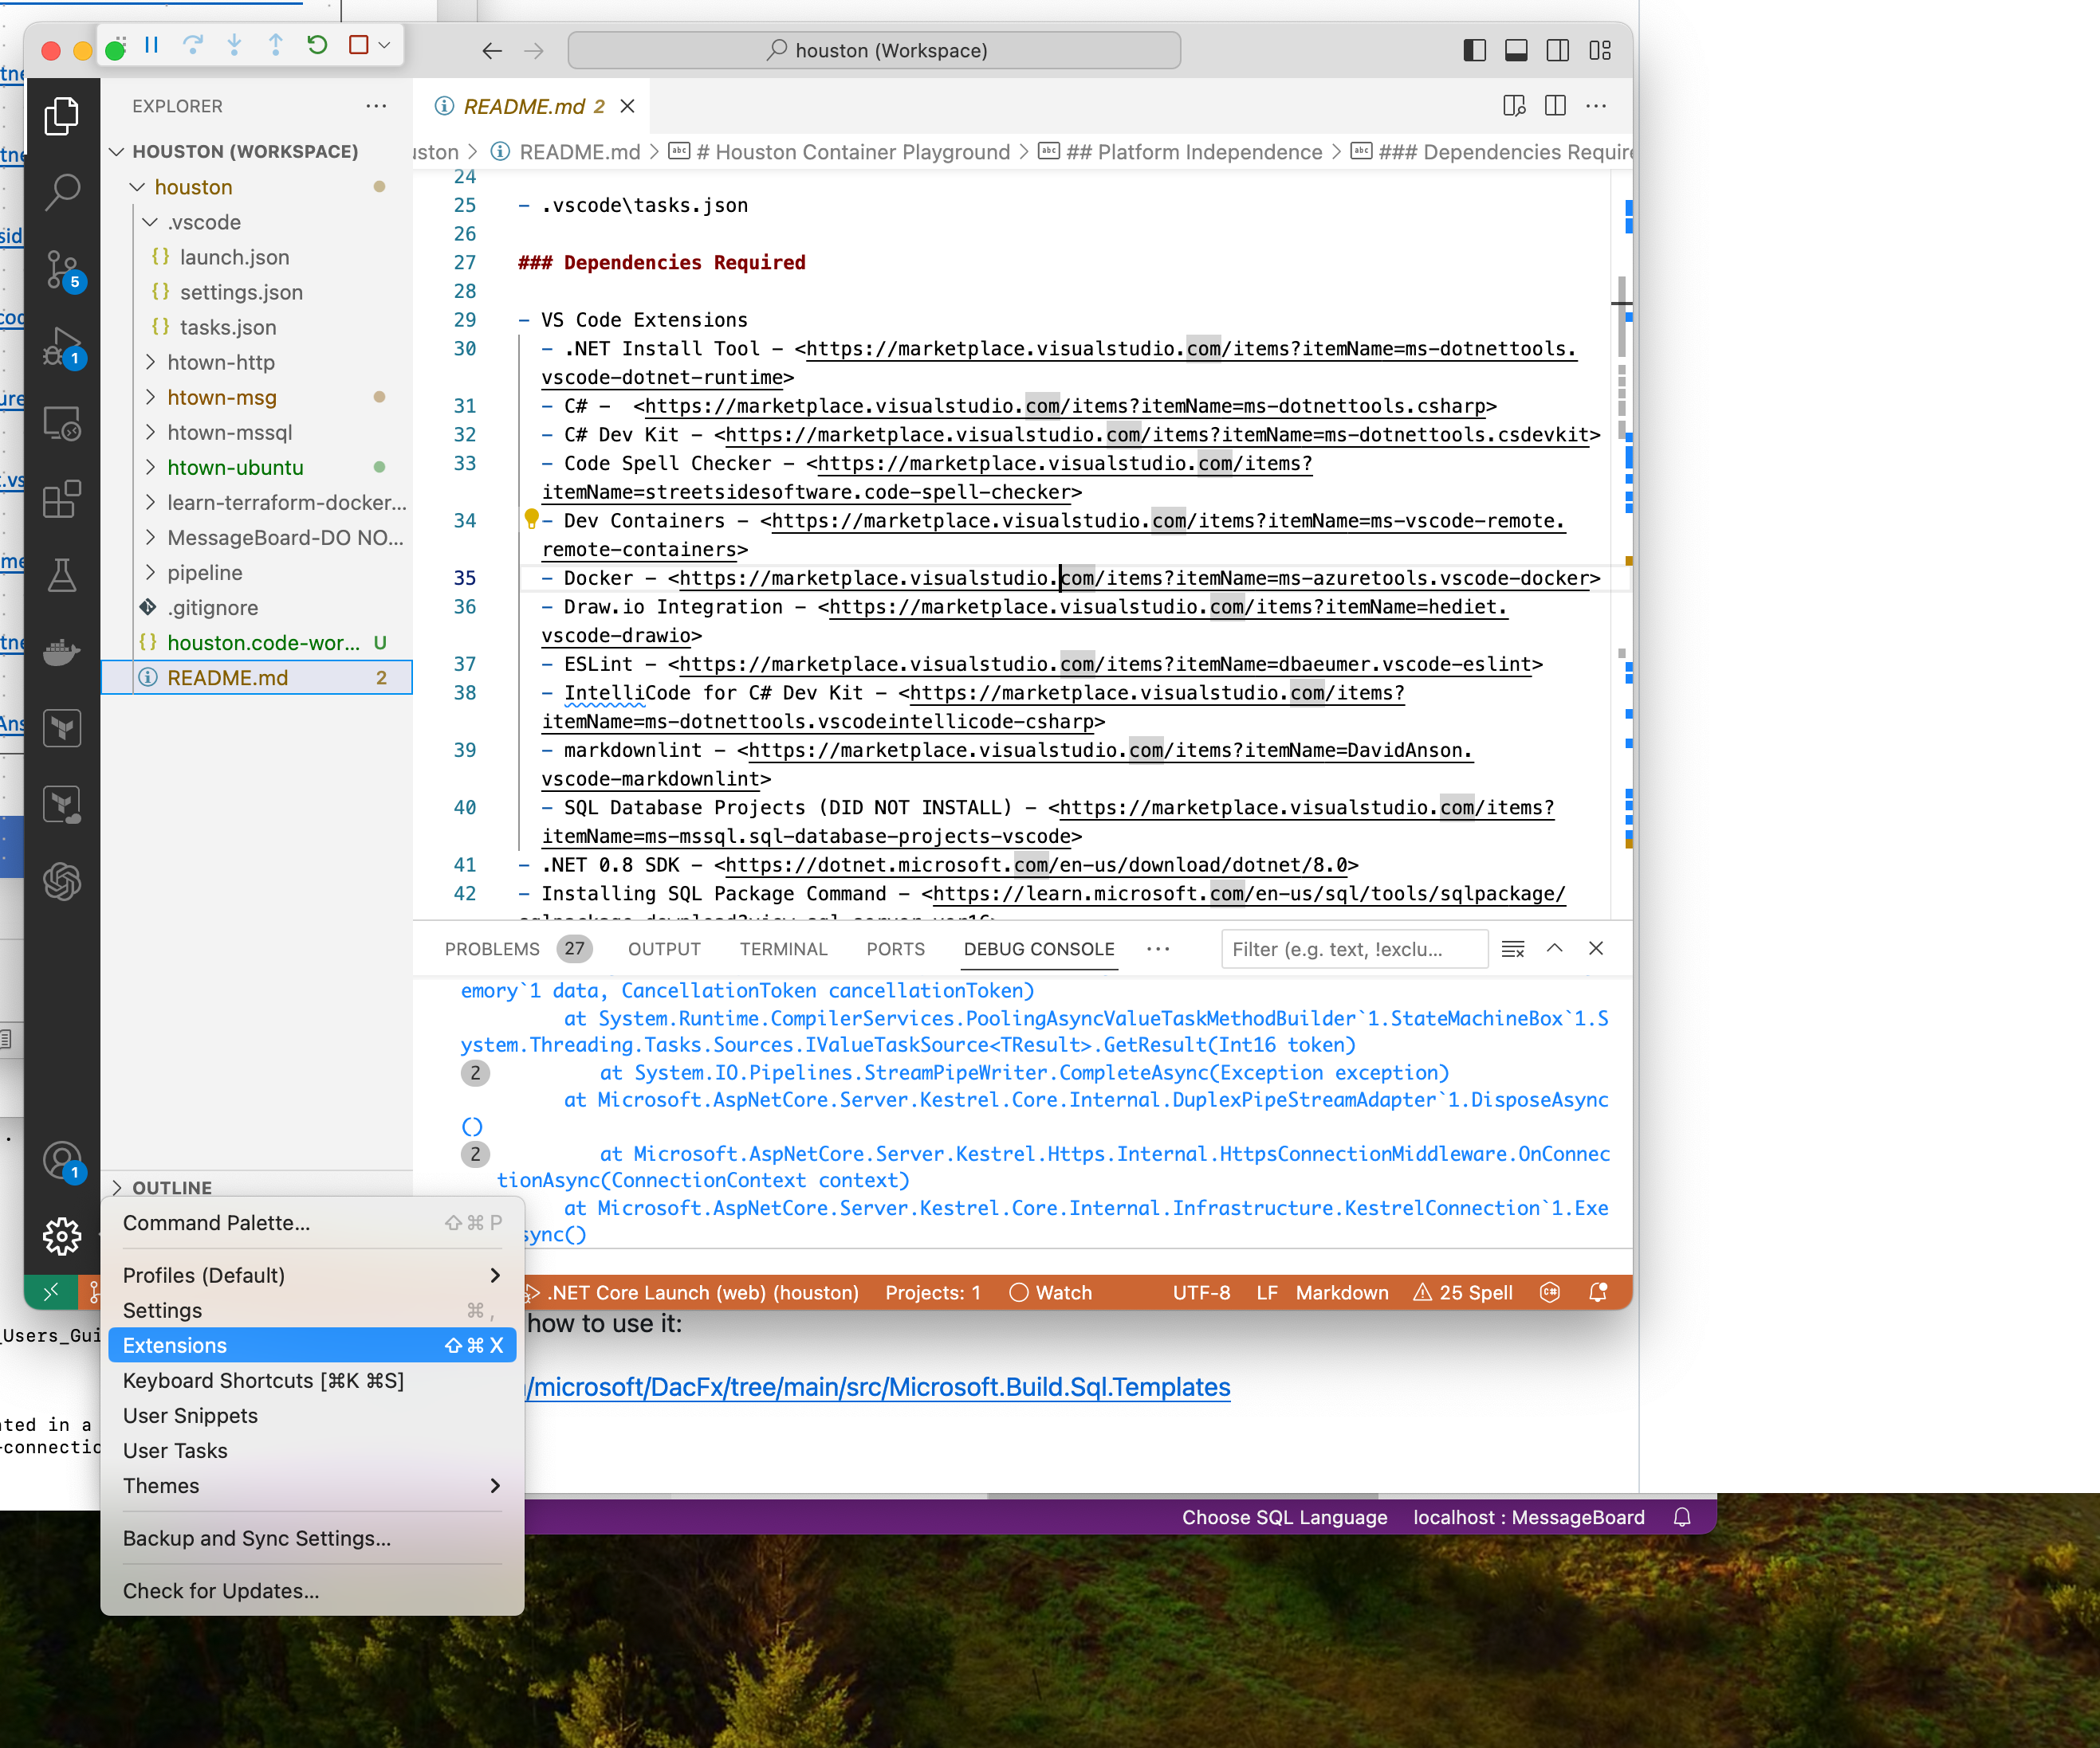
Running Houston Message Board – VS Code – Extensions
VS Code has a plethora of extensions, and you’ll want to install some. Below is a list of extension I’ve installed.
VS Code Extensions .NET Install Tool https://marketplace.visualstudio.com/items?itemName=ms-dotnettools.vscode-dotnet-runtime
C# https://marketplace.visualstudio.com/items?itemName=ms-dotnettools.csharp
C# Dev Kit https://marketplace.visualstudio.com/items?itemName=ms-dotnettools.csdevkit
Code Spell Checker https://marketplace.visualstudio.com/items?itemName=streetsidesoftware.code-spell-checker
Dev Containers https://marketplace.visualstudio.com/items?itemName=ms-vscode-remote.remote-containers
Docker https://marketplace.visualstudio.com/items?itemName=ms-azuretools.vscode-docker
Draw.io Integration https://marketplace.visualstudio.com/items?itemName=hediet.vscode-drawio
ESLint https://marketplace.visualstudio.com/items?itemName=dbaeumer.vscode-eslint
IntelliCode for C# Dev Kit https://marketplace.visualstudio.com/items?itemName=ms-dotnettools.vscodeintellicode-csharp
Markdownlint https://marketplace.visualstudio.com/items?itemName=DavidAnson.vscode-markdownlint
Created by Shawn Zernik on 1/4/2024
Slide 90

Slide 91
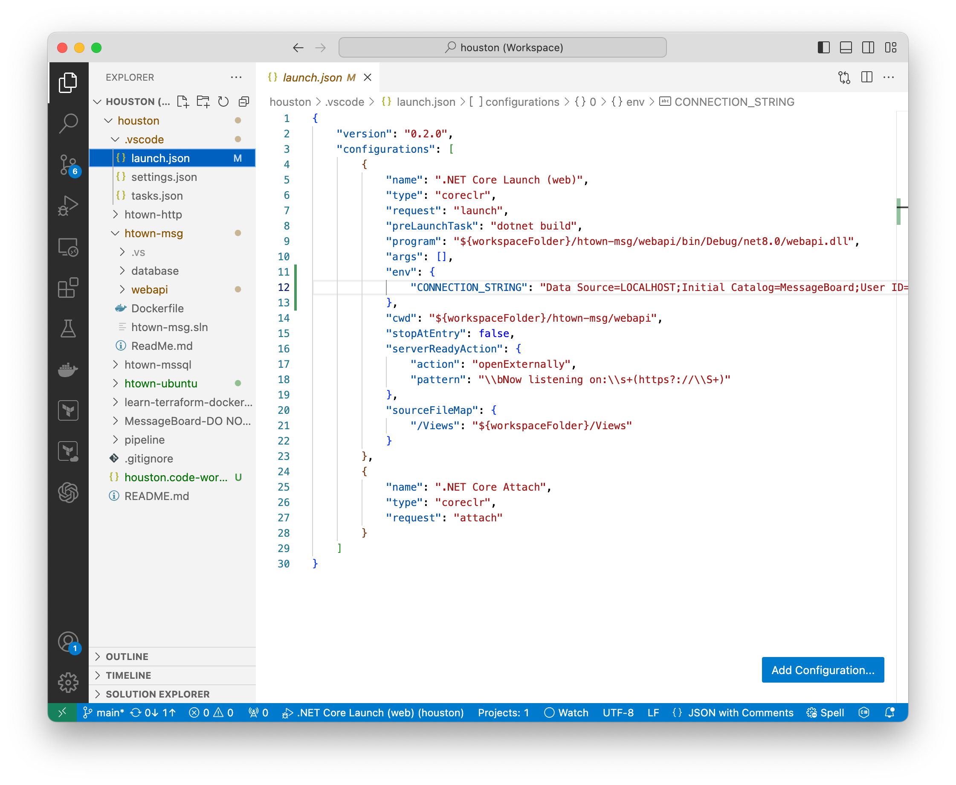
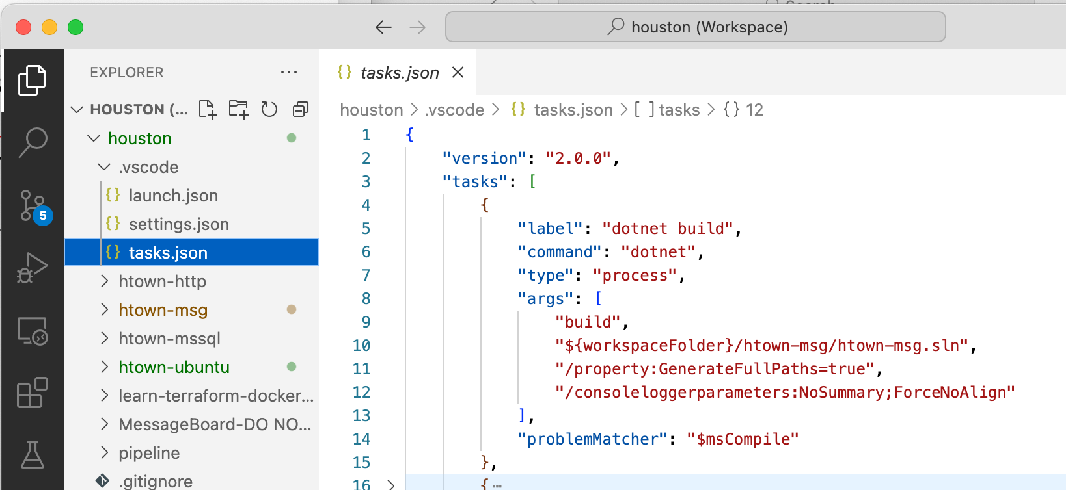
Running Houston Message Board – VS Code – Launch
In the files, there is a “.vscode” folder and a “launch.json” file. This “launch.json” file has the command and settings to run and debug the application. This also references the “build” task to be completed before running / debugging.
The “dotnet build” tasks is defined in the “tasks.json” in the “.vscode” folder. This tells VS Code how to build the application.
Created by Shawn Zernik on 1/4/2024
Slide 91

Slide 92
Running Houston Message Board – VS Code – Launch
We can configure the environment variable for the DB connection string.
Created by Shawn Zernik on 1/4/2024
Slide 92

Slide 93
Running Houston Message Board – VS Code – Launch
This is what should be ran once the build is completed.
For more details on debugging, read the documentation: https://code.visualstudio.com/docs/editor/debugging
Created by Shawn Zernik on 1/4/2024
Slide 93

Slide 94
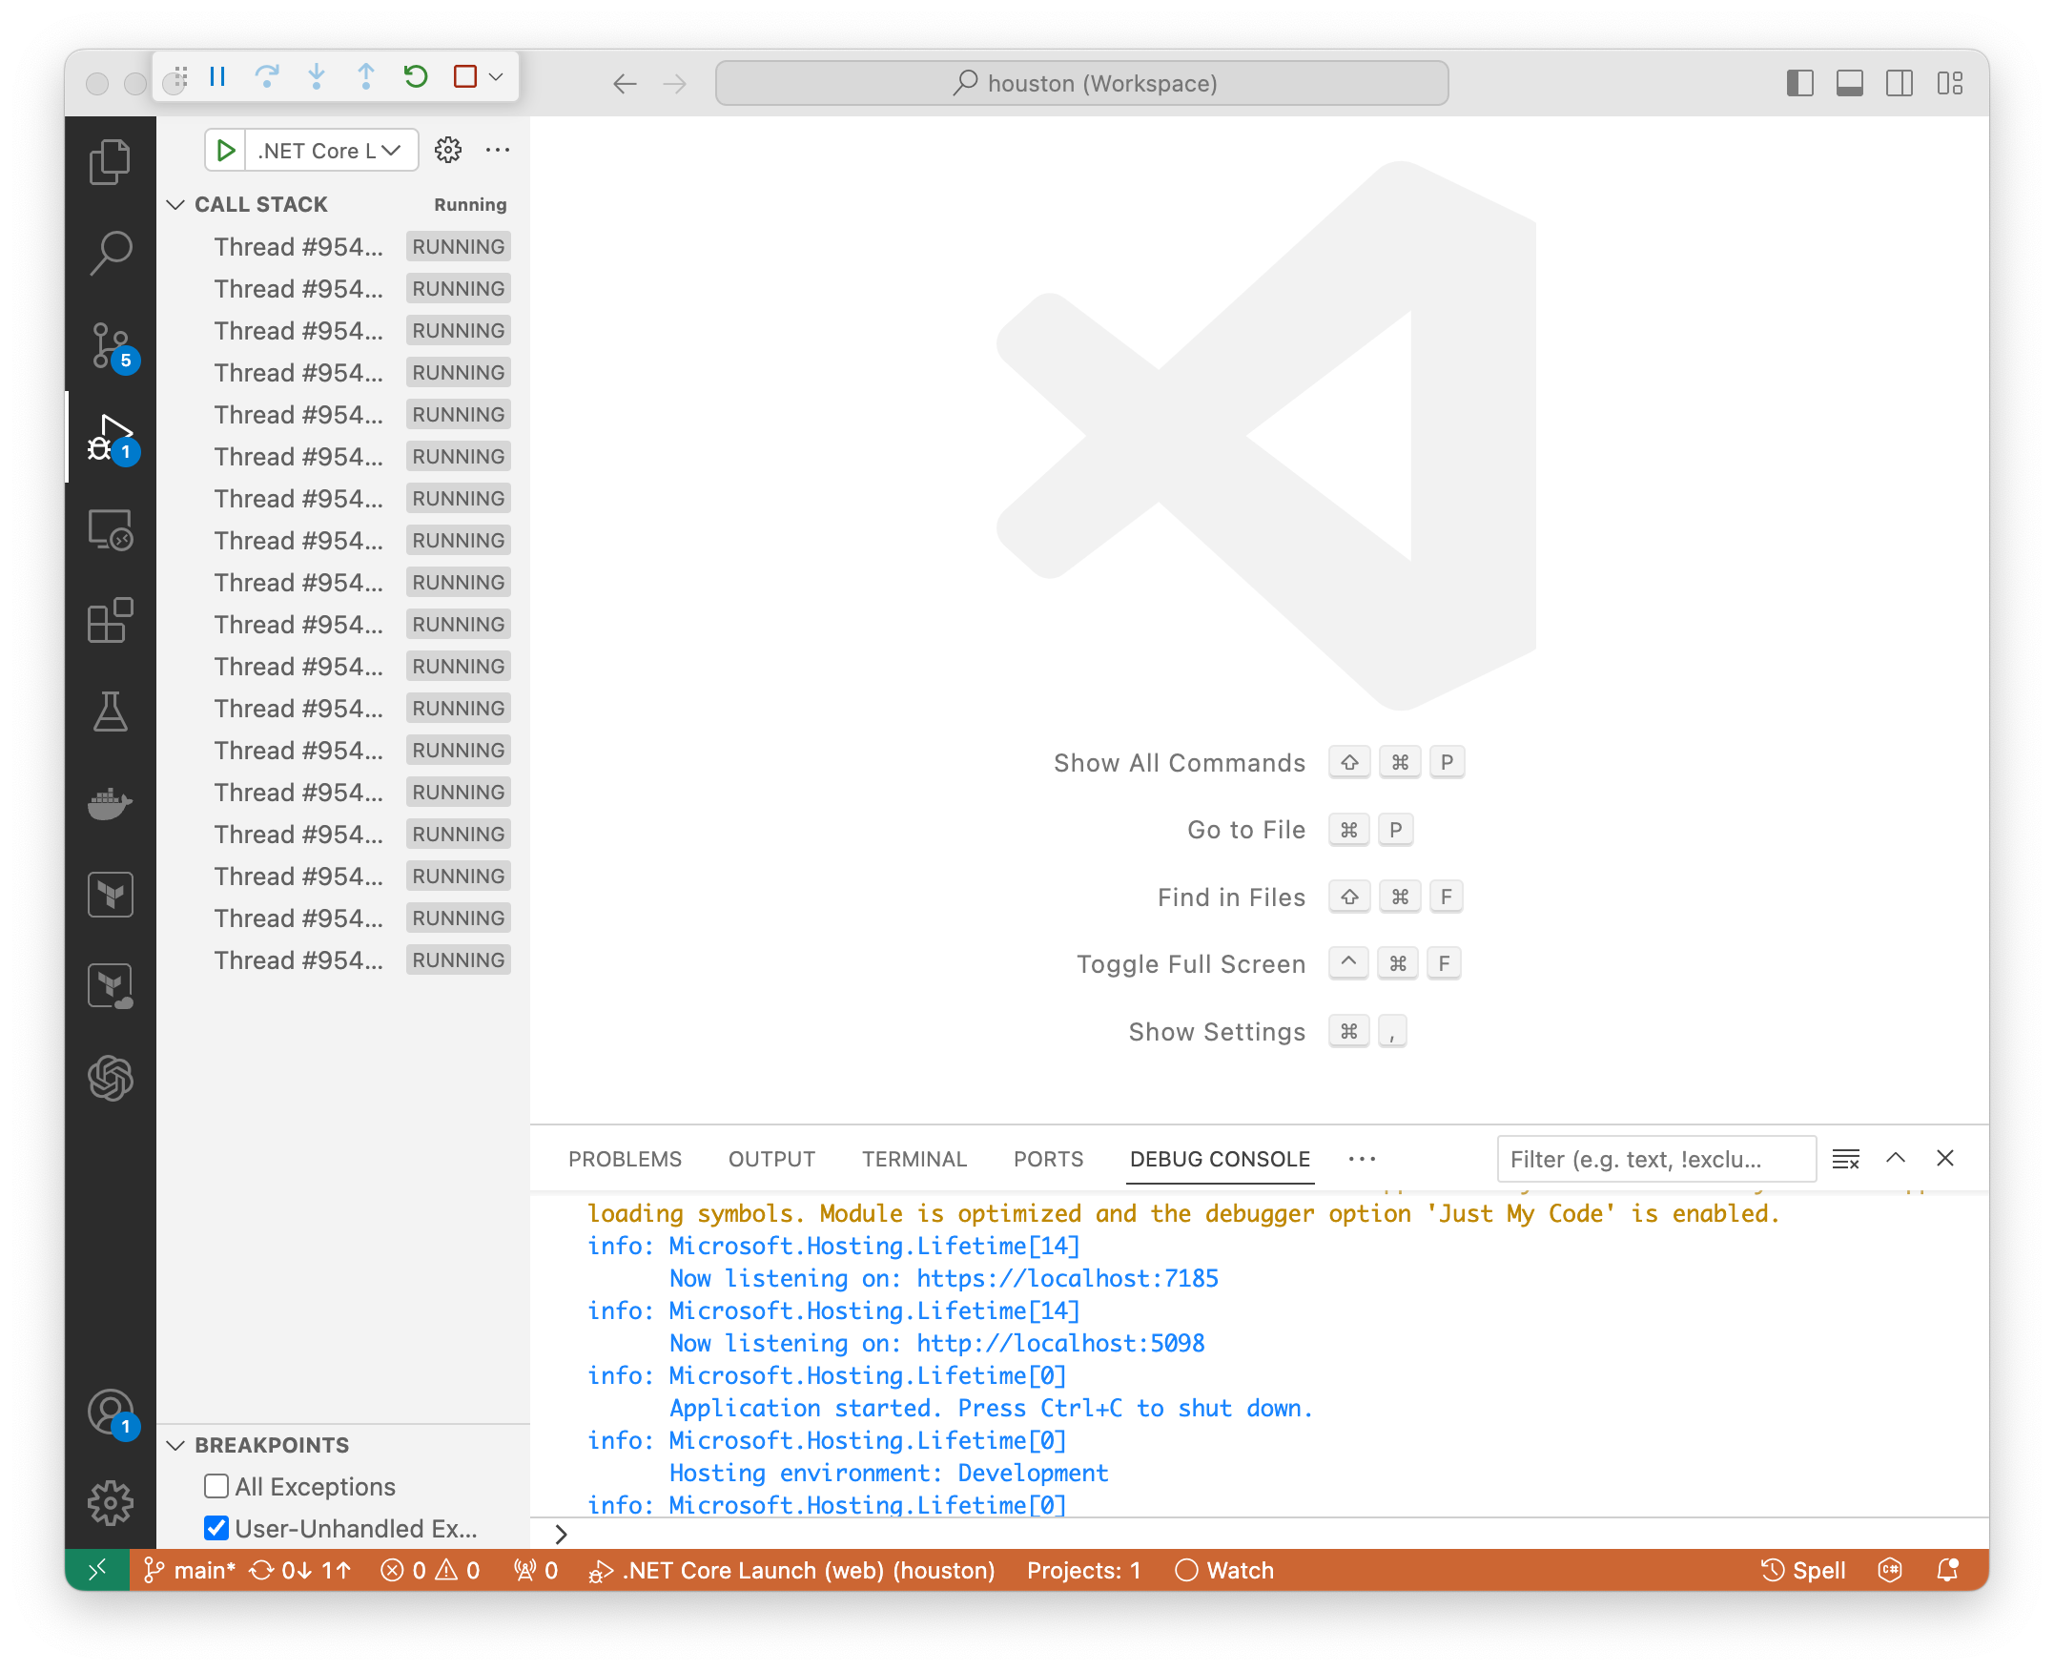
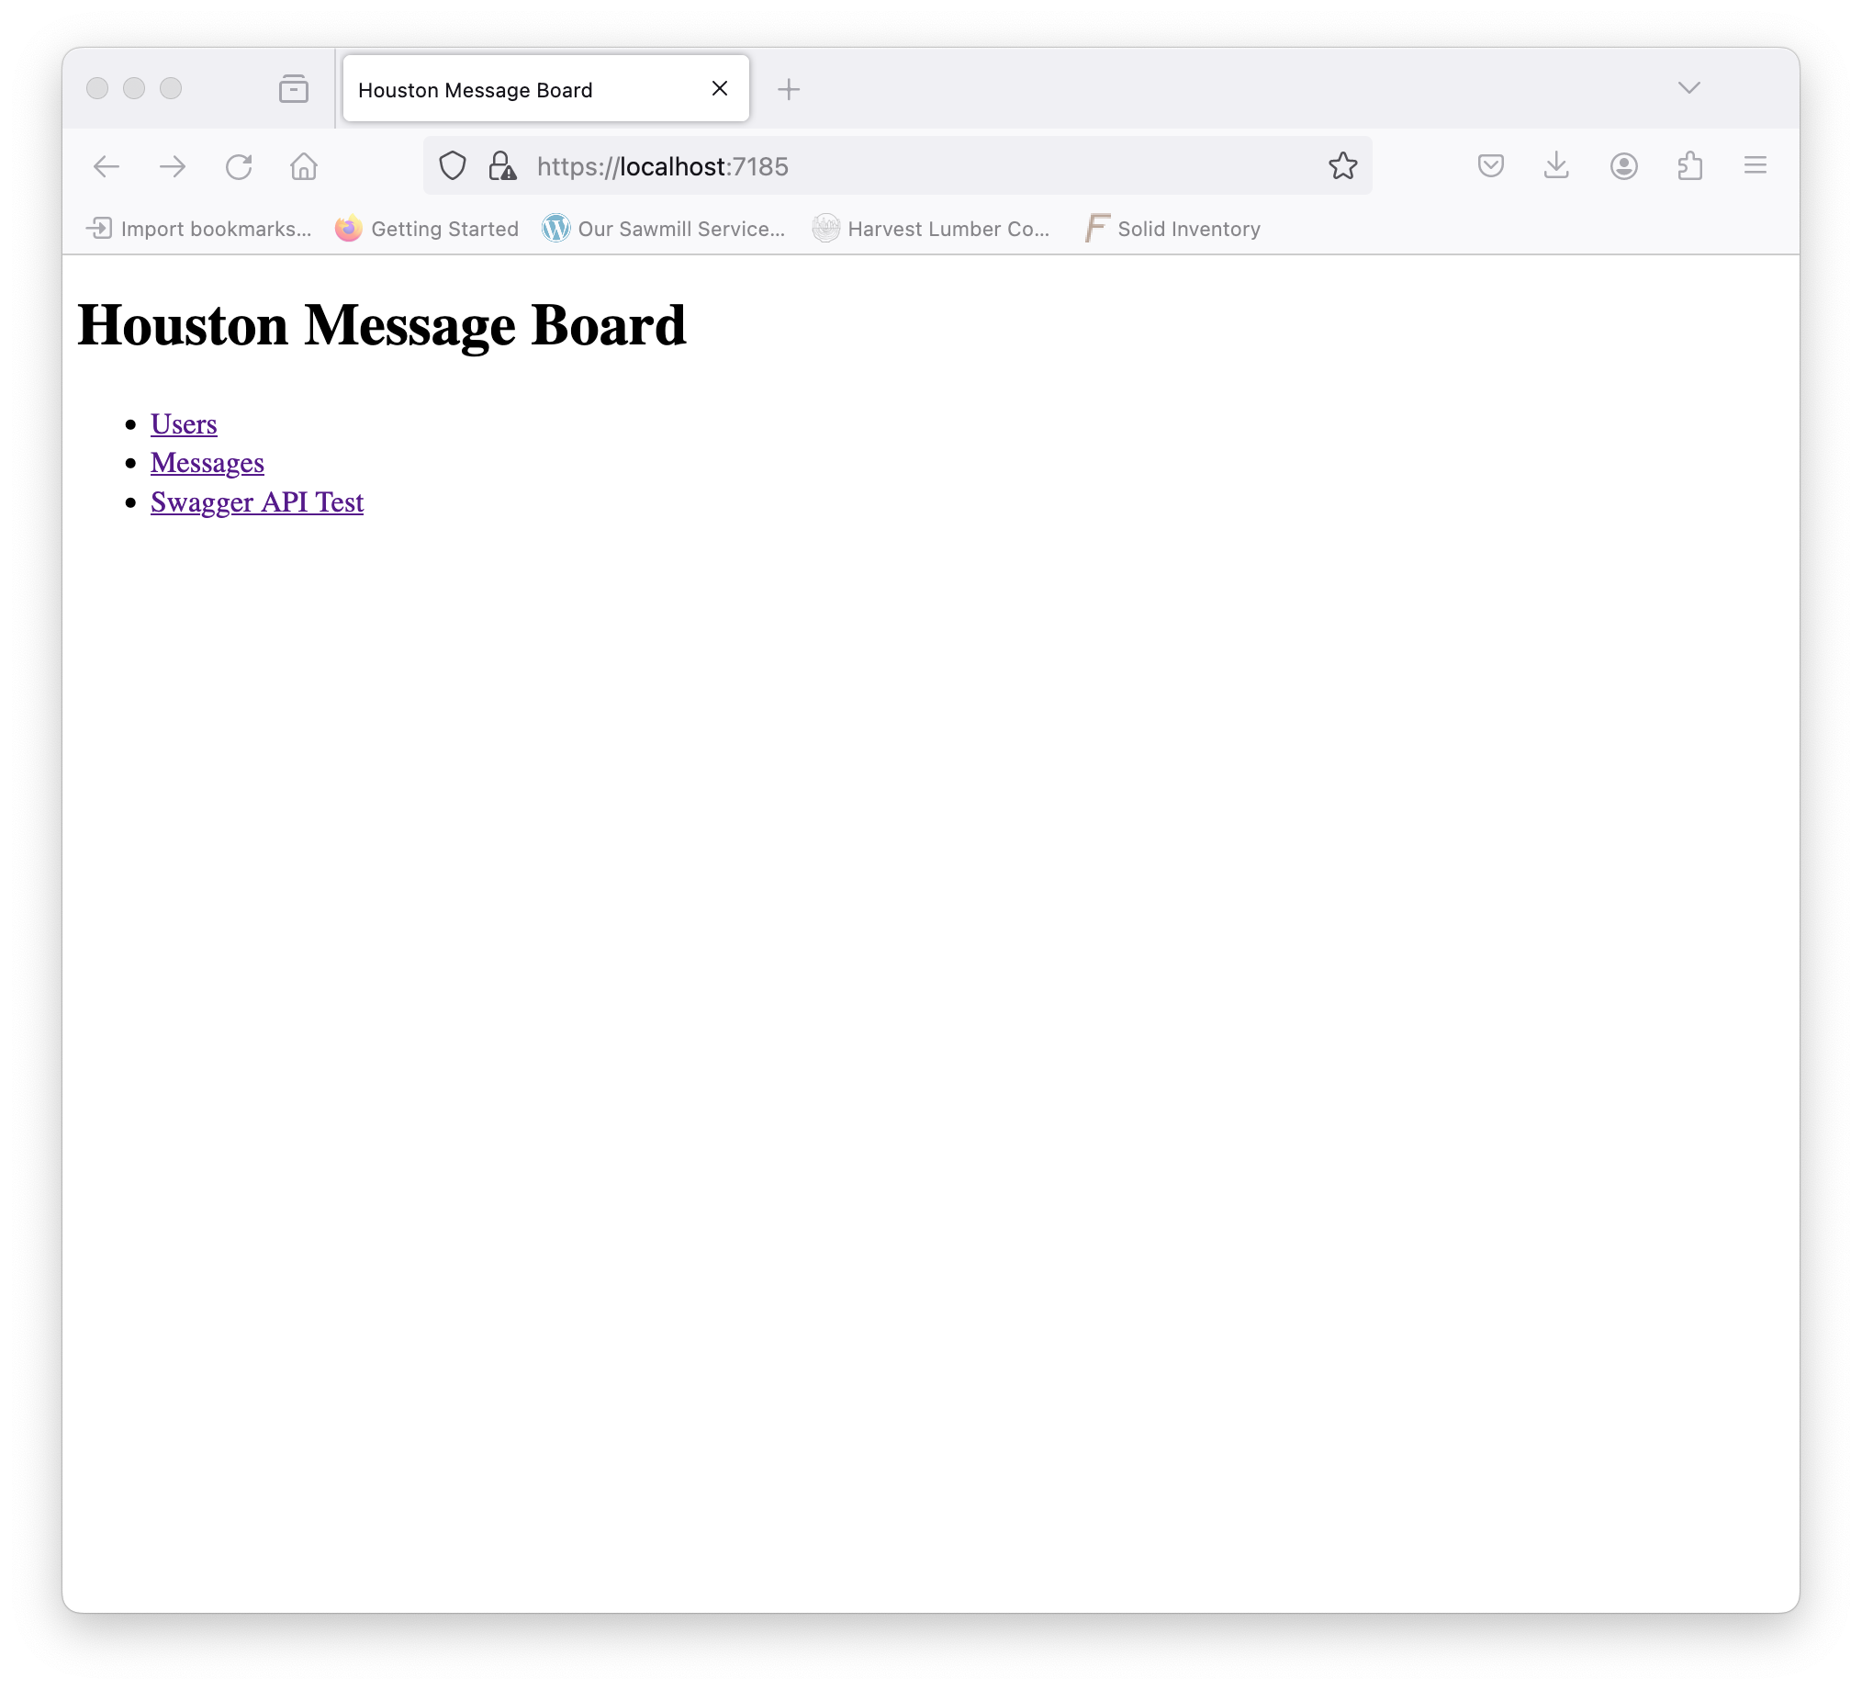
Running Houston Message Board – VS Code – Launch
4
2
1
Go to the “debug” button on the right
Click the play button
The “Debug Console” will populate with build and output
The web browser will open to the site.
3
Created by Shawn Zernik on 1/4/2024
Slide 94

Slide 95
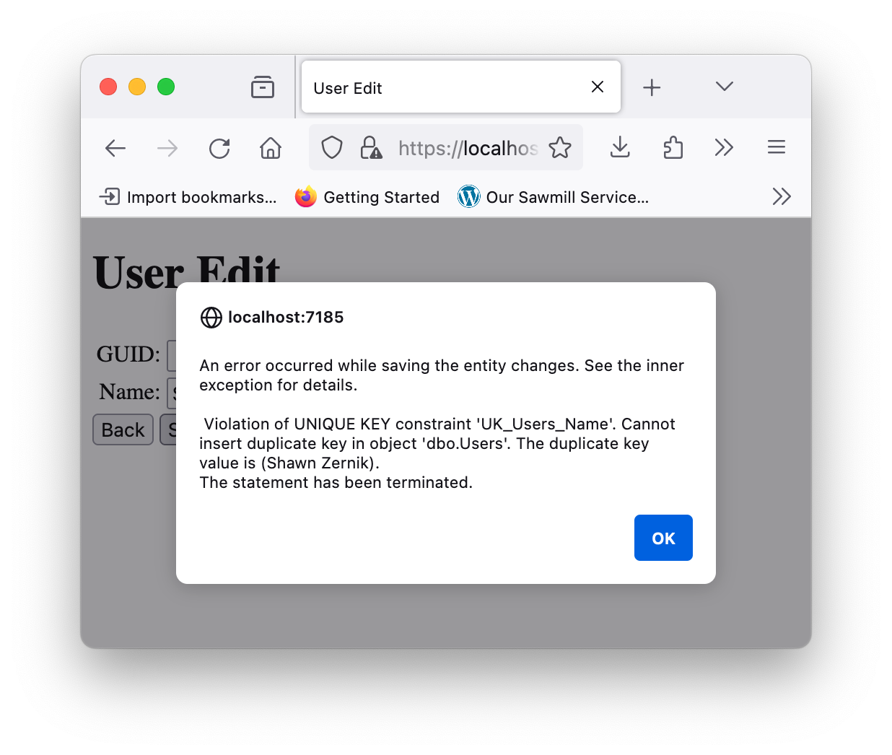
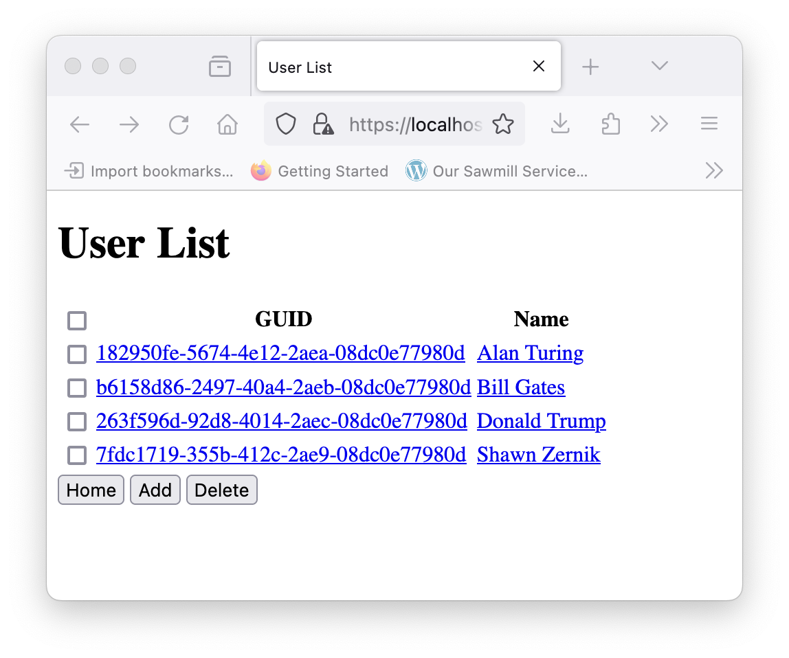
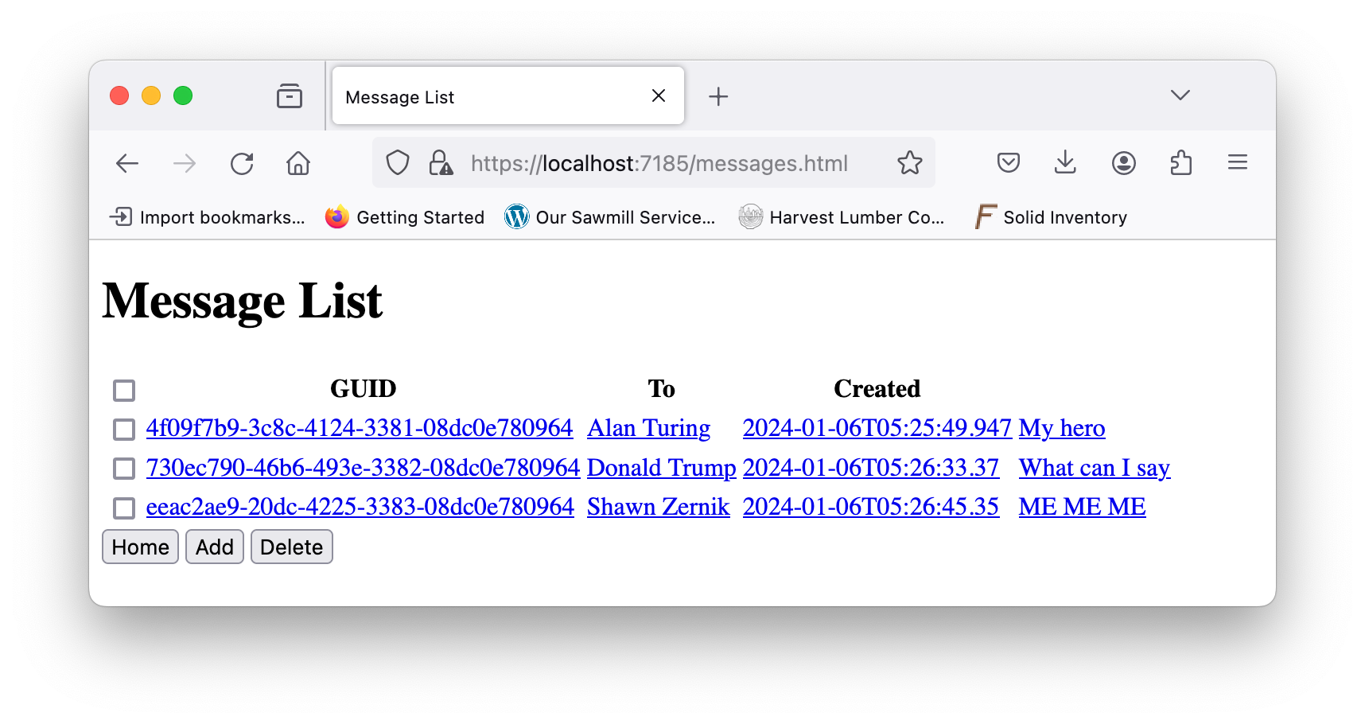

Running Houston Message Board – VS Code – Test & Debug
Play with the app.
Do CRUD (create, read, update, delete) on each of the tables.
Create a duplicate user.
Delete a foreign key.
Add some breakpoints.
Created by Shawn Zernik on 1/4/2024
Slide 95

Slide 96
Application Development with Kubernetes and AWS
2) Running from Command Prompt
Created by Shawn Zernik on 1/4/2024
Slide 96

Slide 97
Running Houston Message Board – Running at Command Prompt
Before we can attempt to build our image and container for the application, we need to understand how to build it at the command prompt. In DotNet Core, the commands will look as follows:
Restore Nuget Packages This will pull in all the dependencies defined by the application. This includes OpenApi, Swagger, Entity Framework, and Logging.
Build Application Building the application will create the “webapi” executable that includes the DotNet Core ASP WebApplication. This will put the files in the “bin\debug” folder but will not include the static content.
Publish Application Publishing the app will put the executables and static content in one folder. This is where we want to run everything.
Created by Shawn Zernik on 1/4/2024
Slide 97

Slide 98

Running Houston Message Board – Running at Command Prompt – Restore NuGet
Run the following command to clean and restore the NuGet packages:
dotnet clean ./htown-msg/webapi/webapi.csproj
dotnet restore ./htown-msg/webapi/webapi.csproj
Created by Shawn Zernik on 1/4/2024
Slide 98

Slide 99

Running Houston Message Board – Running at Command Prompt – Build
Build the executables:
dotnet build ./htown-msg/webapi/webapi.csproj -c Release
Created by Shawn Zernik on 1/4/2024
Slide 99

Slide 100

Running Houston Message Board – Running at Command Prompt – Publish
Publish the web application:
dotnet publish ./htown-msg/webapi/webapi.csproj -c Release
Make note of the published folder.
Let's go look there next.
Created by Shawn Zernik on 1/4/2024
Slide 100

Slide 101

Running Houston Message Board – Running at Command Prompt – Inspect
Inspect the published folder:
cd ./htown-msg/webapi/bin/Release/net8.0/publish/
ls
Created by Shawn Zernik on 1/4/2024
Slide 101

Slide 102
Running Houston Message Board – Running at Command Prompt – Inspect
Inspect the published folder:
The binary executable.
Created by Shawn Zernik on 1/4/2024
Slide 102

Slide 103
Running Houston Message Board – Running at Command Prompt – Inspect
Inspect the published folder:
Static content.
Created by Shawn Zernik on 1/4/2024
Slide 103

Slide 104
Running Houston Message Board – Running at Command Prompt – Inspect
Inspect the published folder:
Dependencies.
Created by Shawn Zernik on 1/4/2024
Slide 104

Slide 105
Running Houston Message Board – Running at Command Prompt – Inspect
Inspect the published folder:
Configs
Created by Shawn Zernik on 1/4/2024
Slide 105

Slide 106
Running Houston Message Board – Running at Command Prompt – Inspect
Inspect the published folder:
Debug details.
This is used when exceptions are thrown to create a call stack with file name and line numbers.
Created by Shawn Zernik on 1/4/2024
Slide 106

Slide 107



Running Houston Message Board – Running at Command Prompt – Run It!
Run the application:
It works! But wait, I didn’t set the environment variable for the connection string.
Created by Shawn Zernik on 1/4/2024
Slide 107

Slide 108

Running Houston Message Board – Running at Command Prompt – Summary
Notice our logging gives us good output, and the error message is meaningful.
While we forgot to configure the database connection string, everything worked as expected.
We will call this a success and move on to containerization of the web app.
I’ll leave it to you to figure out the connection string in the environment variable.
Created by Shawn Zernik on 1/4/2024
Slide 108

Slide 109
Application Development with Kubernetes and AWS
Containerizing
Created by Shawn Zernik on 1/4/2024
Slide 109

Slide 110
Containerizing
When building a container, you have two options:
Building on your Laptop
Building inside the Container
Created by Shawn Zernik on 1/4/2024
Slide 110

Slide 111
Containerizing – Building on you Laptop
While building on your laptop sound like an easier option, and the Dockerfile would be simplified, it poses some problems. We need to consider that containers generally run on Linux, and a few run on Windows.
When you compile an application, it compiles for the operating system you are currently using. For most cases, this will either be Windows or Mac. This will not work for targeting Linux containers.
Secondly, and again, when compiling on your computer, it targets your computer’s architecture. A Mac will generate ARM code. Windows will generate AMD64 code. This may not work depending on the architecture of you target Kubernetes cluster.
In the case where the operating system and architecture do not match the executable, you’ll get:
exec format error
Created by Shawn Zernik on 1/4/2024
Slide 111

Slide 112
Application Development with Kubernetes and AWS
2) Building in the Container
Created by Shawn Zernik on 1/4/2024
Slide 112

Slide 113

Containerizing – Dockerfile Explanation
The Dockerfile is as follows:
Start with our base image.
Call this working copy “base”.
Created by Shawn Zernik on 1/4/2024
Slide 113

Slide 114
Containerizing – Dockerfile Explanation
The Dockerfile is as follows:
The unix user will be “app”.
Created by Shawn Zernik on 1/4/2024
Slide 114

Slide 115
Containerizing – Dockerfile Explanation
The Dockerfile is as follows:
Set current working directory to “/app”.
Created by Shawn Zernik on 1/4/2024
Slide 115

Slide 116
Containerizing – Dockerfile Explanation
The Dockerfile is as follows:
Define that we will be exposing port 8080.
This is an environment variable in the .NET base images.
Environment variable override config files.
Created by Shawn Zernik on 1/4/2024
Slide 116

Slide 117
Containerizing – Dockerfile Explanation
The Dockerfile is as follows:
Change base image to SDK and call this “build”.
Created by Shawn Zernik on 1/4/2024
Slide 117

Slide 118
Containerizing – Dockerfile Explanation
The Dockerfile is as follows:
Set working directory to “/src”.
Created by Shawn Zernik on 1/4/2024
Slide 118

Slide 119
Containerizing – Dockerfile Explanation
The Dockerfile is as follows:
Copy our project into “/src” from our local host.
Created by Shawn Zernik on 1/4/2024
Slide 119

Slide 120
Containerizing – Dockerfile Explanation
The Dockerfile is as follows:
Restore and build.
Created by Shawn Zernik on 1/4/2024
Slide 120

Slide 121
Containerizing – Dockerfile Explanation
The Dockerfile is as follows:
Create new base named “publish” from prior “build” base.
Created by Shawn Zernik on 1/4/2024
Slide 121

Slide 122
Containerizing – Dockerfile Explanation
The Dockerfile is as follows:
DotNet publish.
Created by Shawn Zernik on 1/4/2024
Slide 122

Slide 123
Containerizing – Dockerfile Explanation
The Dockerfile is as follows:
Create final from “base”.
Since the base didn’t have the build and publish in it, it’ll be clean and small.
Created by Shawn Zernik on 1/4/2024
Slide 123

Slide 124
Containerizing – Dockerfile Explanation
The Dockerfile is as follows:
Set working directory to “/app”.
Created by Shawn Zernik on 1/4/2024
Slide 124

Slide 125
Containerizing – Dockerfile Explanation
The Dockerfile is as follows:
Copy from “publish” the “/app/publish” folder into “/app”.
Created by Shawn Zernik on 1/4/2024
Slide 125

Slide 126
Containerizing – Dockerfile Explanation
The Dockerfile is as follows:
Set program to execute when starting container.
Created by Shawn Zernik on 1/4/2024
Slide 126

Slide 127

Containerizing – Build Image
Build the image:
docker build -t szmsg .
Created by Shawn Zernik on 1/4/2024
Slide 127

Slide 128

Containerizing – Copy into Container
Create the container:
docker create \
-e CONNECTION_STRING="Data Source=htown-mssql;Initial Catalog=MessageBoard;User ID=sa;Password=Welcome123;TrustServerCertificate=Yes" \
-p 80:8080 \
--network houston \
--name htown-msg \
szmsg
Created by Shawn Zernik on 1/4/2024
Slide 128

Slide 129

Containerizing – Start the Container
Start the container:
docker start htown-msg
Created by Shawn Zernik on 1/4/2024
Slide 129

Slide 130

Containerizing – Test the Container
Test it out.
http://localhost
Note the “-p” options:
-p 80:8080
Inside the container, the web server is hosting on port 8080. But from my computer I used port 80.
The “-p outside:inside” is the pattern.
Remember, you need to have the MS SQL running.
Created by Shawn Zernik on 1/4/2024
Slide 130

Slide 131
Containerizing – Conclusion
Now we have the tools needed to containerize custom and off the shelf applications. The next step is to work on running those in a production style environment – Kubernetes.
Created by Shawn Zernik on 1/4/2024
Slide 131

Slide 132
Application Development with Kubernetes and AWS
Amazon Web Services
Created by Shawn Zernik on 1/4/2024
Slide 132

Slide 133
AWS
Before we start working with Kubernetes in AWS, we need to cover some basics:
AWS Account Setup
Multifactor Authentication
Root & Subaccount
Users, Roles, and Policies
Network Setup
VPC
Subnets
Public IP Addresses
Routes
Internet Gateway
Security Groups
OpenVPN
Deployment Scripts
Container Build
Terraform
Database Publish
Kubernetes Deployment
Created by Shawn Zernik on 1/4/2024
Slide 133

Slide 134
AWS
Account Setup
Created by Shawn Zernik on 1/4/2024
Slide 134

Slide 135
AWS – Multifactor Authentication
The first action to take when setting up you AWS account is multifactor authentication. You’ll want to go to IAM and set that up immediately.
Follow these directions:
https://docs.aws.amazon.com/IAM/latest/UserGuide/enable-virt-mfa-for-root.html
Created by Shawn Zernik on 1/4/2024
Slide 135

Slide 136
AWS
Subaccount
Created by Shawn Zernik on 1/4/2024
Slide 136

Slide 137
AWS – Subaccount
When working on projects in AWS, and to keep your primary account pristine, we can use subaccounts. Another advantage of subaccounts is when you are done and delete it, effectively everything is deleted, and billing is stopped.
Setup Workmail
Create email address for subaccount
Create subaccount
Created by Shawn Zernik on 1/4/2024
Slide 137

Slide 138

AWS – Subaccount – WorkMail – Setup
Search in for “WorkMail” and select “Amazon WorkMail”.
Created by Shawn Zernik on 1/4/2024
Slide 138

Slide 139

AWS – Subaccount – WorkMail – Setup
Then choose a region:
Created by Shawn Zernik on 1/4/2024
Slide 139

Slide 140

AWS – Subaccount – WorkMail – Setup
Click “Create organization”. As with all AWS service, be conscious of pricing. This is $4.00 per user per month.
Created by Shawn Zernik on 1/4/2024
Slide 140

Slide 141

AWS – Subaccount – WorkMail – Setup
Click “Create organization”. As with all AWS service, be conscious of pricing. This is $4.00 per user per month.
Setup a “free test domain”. You’ll need to provide a name.
In this instance, we choose “lagovistatech”.
Our email addresses will be “lagovistatech.awsapps.com”.
This will be sufficient for creating subaccounts.
Next, go to workmail and add you a user.
Created by Shawn Zernik on 1/4/2024
Slide 141

Slide 142

AWS – Subaccount – WorkMail – Setup
Since WorkMail charges by user’s email account, we can simply add an “alias”. This creates a second email address for the same user.
Search for “workmail” and choose “Amazon WorkMail”
Select your organization
Select “user” from the navigation panel on the left
Select your user name
Select “alias – new” in the tab divider on the bottom half of the screen
Click “add alias” in the top right of tabbed divider on the bottom half of the screen
Make the alias the same name as the subaccount. This will make keeping track easier as each account needs a unique email address.
Created by Shawn Zernik on 1/4/2024
Slide 142

Slide 143


AWS – Subaccount – Creation
In the top right, selection your root account user’s name, and then choose “organization”.
Then click “add an AWS account”.
Created by Shawn Zernik on 1/4/2024
Slide 143

Slide 144

AWS – Subaccount – Creation
On the “Add an AWS account” screen, please fill the form out as follows:
Select “Create an AWS Account”
AWS account name: project name you want for the account. I generally match these to the email alias I setup for the account.
Email address of the account’s owner: use the alias email address you setup for the account.
IAM role name: leave this to the default value.
Scroll to the bottom and click “Create AWS account”.
You should see the account listed along with the account ID and email address.
The first-time logging into a subaccount, you’ll need to do a ”forgot password” and use the email address to reset and establish the password for the account. Once logged in, setup MFA and create you a user.
Created by Shawn Zernik on 1/4/2024
Slide 144

Slide 145
AWS – Subaccount
While a subaccount is not necessary, it does make managing an organization and multiple projects simpler.
It isolates resources and changes.
It gives you a sandbox environment you can play in a break without messing up you AWS account.
When you are done and want to delete everything and stop being billed, you have one point to delete – the sub account.
I strongly recommend using subaccounts. I reserve my “root” account for global services such as email.
Created by Shawn Zernik on 1/4/2024
Slide 145

Slide 146
AWS
Role Based Access Control (RBAC)
Created by Shawn Zernik on 1/4/2024
Slide 146

Slide 147
AWS – Role Based Access Control (RBAC)
Once you have an account your can play with, we need to provision a user. Do not use the root account – it’s a bad practice and should not be done even when playing. But let's get a feel for AWS permissions system before we start configuring it.
Groups
User
Role
Policy
Groups contain users.
Users can authenticate and log in.
Roles link policies to users.
Policies define a scope and actions.
All of this is configured through Identity Account Management (IAM). Roles can be applied to AWS resources such as EC2 instances, Lambda functions, etc. They will assume the policies, right, and permissions defined in the associated roles.
Created by Shawn Zernik on 1/4/2024
Slide 147

Slide 148

AWS – Policies
Policies are the heart of the AWS permissions system. Here’s an example of the AdministratorAccess policy.
Never apply the administrator policies. AWS will remove the access to the account giving out administrator access using automation.
Always use the Principal of Least Privilege: https://en.wikipedia.org/wiki/Principle_of_least_privilege.
Created by Shawn Zernik on 1/4/2024
Slide 148

Slide 149

AWS – Policies
Let's consider something a little more complex – the standard read only policy for S3 storage:
“Allow” or “Deny” the listed actions.
Created by Shawn Zernik on 1/4/2024
Slide 149

Slide 150
AWS – Policies
Let's consider something a little more complex – the standard read only policy for S3 storage:
Lists out the resource specific actions that resource can have.
“*” is a wildcard that’ll match anything.
Complete list of actions:
https://docs.aws.amazon.com/AmazonS3/latest/API/API_Operations.html
Created by Shawn Zernik on 1/4/2024
Slide 150

Slide 151
AWS – Policies
Let's consider something a little more complex – the standard read only policy for S3 storage:
Allows you to lock down the permission to a specific instance of a resource using the AWS Resource Name (ARN).
“*” mean all.
S3 ARN format:
https://docs.aws.amazon.com/AmazonS3/latest/userguide/s3-arn-format.html
Created by Shawn Zernik on 1/4/2024
Slide 151

Slide 152
AWS – Policies
This should be enough to get started and follow through this document. For further information on policies, please refer to the AWS documentation:
https://docs.aws.amazon.com/IAM/latest/UserGuide/reference_policies.html
Created by Shawn Zernik on 1/4/2024
Slide 152

Slide 153
AWS
Network Setup
Created by Shawn Zernik on 1/4/2024
Slide 153

Slide 154
AWS – Network Overview
Below is a diagram of the target AWS network we will be setting up. We will walk you through some of the technicalities of this design.
The network in AWS is defined as your “Virtual Private Cloud”. This VPC is then divided into subnets – each in a different availability zone or having a different purpose (private vs public access). The network will have some routes defined that then point to an internet gateway. The internet gateway routes anything with a public IP address attached to it.
Virtual Private Cloud (172.31.0.0/16)
Subnet (172.31.0.0/20)
Subnet (172.31.16.0/20)
Subnet (172.31.32.0/20)
K8s
Node
K8s
Node
OpenVPN
MS SQL
Internet
Internet Gateway
Created by Shawn Zernik on 1/4/2024
Slide 154

Slide 155

AWS – Network Overview – VPC and Subnet Sizing
As you noticed a VPC is divided into subnets. The number of subnets you can have the difference if the VPC CIDR size, and the subnet CIDR size.
Example VPC: 10.0.0.0/16 – Subnets 10.0.X.0/20 → 4 bits for subnets = 16 max subnets
Example VPC: 192.168.0.0/16 – Subnets 192.168.X.0/24 → 8 bits for subnets = 256 subnets
Example VPC: 172.30.0.0/23 – Subnets 172.30.X.0/24 → 1 bit for subnets = 2 subnets
We recommend a VPC CIDR size of 16 – this maximizes the network addresses available to you while also keeping the math on the subnets easy. It effectively isolates the complexity to the third byte.
Max Subnets = 2 ^ (Subnet CIDR – VPC CIDR)
Max Host = 2 ^ (32 – Subnet CIDR)
VPC CIDR | Subnets CIDR | Subnets | Possible Subnets | Subnet IP Addresses
/16 | /17 | 2 | 0, 128 | 32,786
/16 | /18 | 4 | 0, 64, 128, 192 | 16,384
/16 | /19 | 8 | 0, 32, 64, 96, 128, 160, 192, 224 | 8,192
/16 | /20 | 16 | 0, 16, 32, 48, 64, 80, 96, 112, 128, 144, 160, 176, 192, 208, 224, 240 | 4,096
/16 | /21 | 32 | 0, 8, 16, …, 232, 240, 248 | 1,024
/16 | /22 | 64 | 0, 4, 8, 12, …, 244, 248, 252 | 1024
/16 | /23 | 128 | 0, 2, 4, 6, 8, …, 250, 252, 254 | 512
/16 | /24 | 256 | 0, 1, 2, 3, 4, …, 253, 254, 255 | 256
Use the attached spreadsheet to explore network addressing:
Created by Shawn Zernik on 1/4/2024
Slide 155

Slide 156

AWS – Network Overview – Subnets
Subnets are intended to separate out resources on the network. Key defining properties of the subnet is around availability zones.
They define physically where the resource should live – on what networks. This is in case an availability zone goes down, it’s highly available counterpart can continue to service clients in the online availability zone.
Subnets do not all have to be the same size (/20), but should not overlap.
Subnets can also enable the auto-assigning of public IPv4 addresses. Turn this off on all subnets.
Created by Shawn Zernik on 1/4/2024
Slide 156

Slide 157
AWS – Network Overview – Public IP Addresses
Make sure to turn off automatic assigning of IP addresses on your subnets. The idea here is nothing should go on the internet without conceded efforts to make it so. While AWS charges for Elastic IP addresses, they are about to the do the same for “auto-assigned public IP addresses”. To put something on the internet, we’ll want to complete the following:
Allocate an Elastic IP address
Assign the Elastic IP address to the resource or the resources network interface.
The “internet gateway” will only route traffic using public IP addresses. On the default network setup, without a public IP address, your resource will not be able to go out on the internet.
Created by Shawn Zernik on 1/4/2024
Slide 157

Slide 158

AWS – Network Overview – Routes
You VPC can have routes defined. The following are the routes on my VPC:
0.0.0.0 – this is the default route for all less specific traffic – if forward the traffic to the internet gateway.
10.0.0.0/16 – this destination keeps all traffic on the local network
If we had a router/bridge/gateway on our VPC, we could add additional routes to make traffic flow to those connected networks. Again, if the destination doesn’t match one of the records, it will go to 0.0.0.0.
Created by Shawn Zernik on 1/4/2024
Slide 158

Slide 159
AWS – Network Overview – Gateways & Routers
The “internet gateway” has no cost associated with it, but it will not provide NAT services. Without NAT or a public IP address, our devices on the VPC will not be able to access the internet.
Router / Bridge | Comments | Cost
Internet Gateway | Routes traffic to the internet if the resource has a public IP address (auto assigned or elastic). | Free
NAT Gateway (Public) | Allows all private IP addresses access to the internet via a NAT. | $34 / month +
Netgate pfSense Plus Firewall/VPN/Router | A virtual router EC2 instance. | $0.10 / hour
If you use a virtual router, you’ll need to modify the route table for 0.0.0.0 to point to your virtual router rather than the internet gateway. You’ll also have to configure your virtual router with a public IP and establish internet gateway connectivity.
For our purposes, I’ve allocated elastic IP addresses to the devices that need internet access on demand for the time it’s needed. Then I remove the public IP address. This way I can control what has internet access when.
In a production environment, we would want some type of NAT.
Created by Shawn Zernik on 1/4/2024
Slide 159

Slide 160


AWS – Network Overview – Security Groups and Network ACLs
Security Groups and Network ACLs act as firewalls in AWS. The difference is Security Groups operate in instances, and Network ACLs operate on subnets.
Security Group
Network ACL
For our purposes, we will be managing Security Groups. For details on security groups, please refer to the AWS documentation:
https://docs.aws.amazon.com/vpc/latest/userguide/security-group-rules.html
Created by Shawn Zernik on 1/4/2024
Slide 160

Slide 161
AWS
OpenVPN
Created by Shawn Zernik on 1/4/2024
Slide 161

Slide 162


AWS – OpenVPN
Since everything in our VPC is not on the internet, and we don’t want public internet access to our application and resources, we need to some way to access them.
We could create a VM in EC2 we use as our desktop - this would be expensive and not the experience developers are used to.
Instead, we will create a small instance of OpenVPN. This will save us the cost of a big EC2 instance to serve as our desktop and provide a more realistic corporate environment where we can access resources with our laptops.
Use the following document to configure OpenVPN.
Created by Shawn Zernik on 1/4/2024
Slide 162

Slide 163
AWS
Setup ECR
(Elastic Container Registry)
Created by Shawn Zernik on 1/4/2024
Slide 163

Slide 164


AWS – Elastic Container Registry
Setup an ECR in your target AWS account. Search for “ECR”. Then click “Get Started”.
Name it as “szmsg” – the container image we are using.
Make note of the repository name and URL.
Created by Shawn Zernik on 1/4/2024
Slide 164

Slide 165
AWS
AWS CLI Access Key
Created by Shawn Zernik on 1/4/2024
Slide 165

Slide 166


AWS – CLI Access Key
Before we can start our AWS deployments, we need to establish and “AWS_ACCESS_KEY_ID” and the “AWS_SECRET_ACCESS_KEY”. This is done in IAM for your user:
AWS will want you to use any other means rather than an access key.
Choose other then next.
Created by Shawn Zernik on 1/4/2024
Slide 166

Slide 167


AWS – CLI Access Key
Use the following inputs:
Save the “Access key” and “Secret access key”.
These will be used to authenticate Terrafrom and the AWS CLI tools.
Created by Shawn Zernik on 1/4/2024
Slide 167

Slide 168
AWS
Deployment:
ECR Publish
Created by Shawn Zernik on 1/4/2024
Slide 168

Slide 169


AWS – Deployment – ECR Publish
We will need to build our image and push it to ECR. The following shell script will do so. We will run all shell scripts to from “${workspace}\pipeline”.
We need to be in the folder that contains the “Dockerfile”.
Created by Shawn Zernik on 1/4/2024
Slide 169

Slide 170
AWS – Deployment – ECR Publish
We will need to build our image and push it to ECR. The following shell script will do so. We will run all shell scripts to from “${workspace}\pipeline”.
This will build our application from source code and create a container image on your computer.
Created by Shawn Zernik on 1/4/2024
Slide 170

Slide 171
AWS – Deployment – ECR Publish
We will need to build our image and push it to ECR. The following shell script will do so. We will run all shell scripts to from “${workspace}\pipeline”.
This sets up the AWS CLI tool to authenticate.
Created by Shawn Zernik on 1/4/2024
Slide 171

Slide 172
AWS – Deployment – ECR Publish
We will need to build our image and push it to ECR. The following shell script will do so. We will run all shell scripts to from “${workspace}\pipeline”.
This connects docker to use your AWS ECR.
Created by Shawn Zernik on 1/4/2024
Slide 172

Slide 173
AWS – Deployment – ECR Publish
We will need to build our image and push it to ECR. The following shell script will do so. We will run all shell scripts to from “${workspace}\pipeline”.
This command tags images so that the source is pushed to the target.
Created by Shawn Zernik on 1/4/2024
Slide 173

Slide 174
AWS – Deployment – ECR Publish
We will need to build our image and push it to ECR. The following shell script will do so. We will run all shell scripts to from “${workspace}\pipeline”.
The following will push the locally tagged image to the target. It knows the target’s repository URL by the “hostname/tag:version”.
Created by Shawn Zernik on 1/4/2024
Slide 174

Slide 175

AWS – Deployment – ECR Publish
This what the out put of the ”build.sh” folder is.
Notice this was ran from the pipeline folder where the “build.sh” lives.
Created by Shawn Zernik on 1/4/2024
Slide 175

Slide 176

AWS – Deployment – ECR Publish
At this point, you’ll have your artifact in the AWS Elastic Container Repository (ECR).
You should see it in AWS ECR. Please note the URI.
Created by Shawn Zernik on 1/4/2024
Slide 176

Slide 177
AWS – Deployment – ECR Publish
Now that we have our container image in the registry, we need to make sure that out infrastructure is valid. This will include:
Microsoft Azure/SQL Database
Kubernetes Cluster
The next step is to run out Terraform scripts.
Created by Shawn Zernik on 1/4/2024
Slide 177

Slide 178
AWS
Deployment:
Terraform
Created by Shawn Zernik on 1/4/2024
Slide 178

Slide 179

AWS – Deployment – Terraform – Provider
This defined the provider and the region.
Terraform will index all “*.tf” files and treat them as one.
For this purpose, we moved provider to it’s own file.
Created by Shawn Zernik on 1/4/2024
Slide 179

Slide 180

AWS – Deployment – Terraform – DB Instance
Resource blocks are defined as:
resource “type” “name” {}
The “aws_security_group”, “aws_db_instance”, and “aws_sb_subnet_grouip” are the resource types referenced in this file.
Documentation specific to these resources can be located here:
https://registry.terraform.io/providers/hashicorp/aws/latest/docs
Created by Shawn Zernik on 1/4/2024
Slide 180

Slide 181
AWS – Deployment – Terraform – DB Instance
In this file, we have three sections:
Red – defines the security group / firewall rules.
Green – defines the database instance
Blue – defined the subnets the database will be connected to
Created by Shawn Zernik on 1/4/2024
Slide 181

Slide 182
AWS – Deployment – Terraform – DB Instance
We start by defining the name and description for the security groups.
Created by Shawn Zernik on 1/4/2024
Slide 182

Slide 183
AWS – Deployment – Terraform – DB Instance
We specify the security groups will be on our VPC.
Created by Shawn Zernik on 1/4/2024
Slide 183

Slide 184
AWS – Deployment – Terraform – DB Instance
Allow all incoming traffic from the VPC identified by CIDR block.
Created by Shawn Zernik on 1/4/2024
Slide 184

Slide 185
AWS – Deployment – Terraform – DB Instance
Allow all outbound traffic.
Created by Shawn Zernik on 1/4/2024
Slide 185

Slide 186
AWS – Deployment – Terraform – DB Instance
We add an “application” tag so we can keep all the services and related items together.
Created by Shawn Zernik on 1/4/2024
Slide 186

Slide 187
AWS – Deployment – Terraform – DB Instance
This next block defined the database instance:
identifier – name
instance_class – this is the EC2 based instance that’ll run the database server
storage_type – GP2 is general purpose SSD 2nd generation
allocated_storage – max storage amount in GB
engine – the type of database server we want: Microsoft SQL Server Express
engine-version – the expected version number: MS SQL 2022
username – the SQL authentication username for the administrator
password - the SQL authentication password for the administrator
Created by Shawn Zernik on 1/4/2024
Slide 187

Slide 188
AWS – Deployment – Terraform – DB Instance
Links the database instance to the security group defined above. This will be the firewall on the database.
Links the database instance to the network’s subnets defined below.
Created by Shawn Zernik on 1/4/2024
Slide 188

Slide 189
AWS – Deployment – Terraform – DB Instance
Defines how many backups to keep, and the time window to do backups.
Created by Shawn Zernik on 1/4/2024
Slide 189

Slide 190
AWS – Deployment – Terraform – DB Instance
Incase of delete, should a final snapshot be taken.
In production, you should have this set to yes incase the database is accidentally deleted.
Created by Shawn Zernik on 1/4/2024
Slide 190

Slide 191
AWS – Deployment – Terraform – DB Instance
This finally defines the subnets the database will be connected to.
Created by Shawn Zernik on 1/4/2024
Slide 191

Slide 192

AWS – Deployment – Terraform – Kubernetes
This defines a new role for the EKS cluster.
In this role, principals od the eks and ec2 services may take the actions defined.
More details can be found here: https://docs.aws.amazon.com/IAM/latest/UserGuide/reference_policies_elements_principal.html#principal-services
Created by Shawn Zernik on 1/4/2024
Slide 192

Slide 193
AWS – Deployment – Terraform – Kubernetes
We go on to attach some standard AWS policies to the role:
EKS Cluster
EKS CNI
EKS Service
EKS VPC Resource Controller
EKS Worker Node
Created by Shawn Zernik on 1/4/2024
Slide 193

Slide 194

AWS – Deployment – Terraform – Kubernetes
Next, we create a custom policy relating to ECR. This provide enough access to the Elastic Container Registry (ECR) for our nodes to download the images they will need.
Created by Shawn Zernik on 1/4/2024
Slide 194

Slide 195
AWS – Deployment – Terraform – Kubernetes
Attach the above policy to our role our cluster and nodes will use.
Created by Shawn Zernik on 1/4/2024
Slide 195

Slide 196

AWS – Deployment – Terraform – Kubernetes
This first block defined some of our firewall rules. Specifically, that we want to allow inbound from the VPC network and allow all outbound.
These firewall rules will attach to the nodes.
The second block start to define our cluster. A cluster is made of nodes and those will come next.
Created by Shawn Zernik on 1/4/2024
Slide 196

Slide 197
AWS – Deployment – Terraform – Kubernetes
Attach the role defined to the cluster.
Created by Shawn Zernik on 1/4/2024
Slide 197

Slide 198
AWS – Deployment – Terraform – Kubernetes
Applied the firewall defined on the last slide to the cluster.
Created by Shawn Zernik on 1/4/2024
Slide 198

Slide 199
AWS – Deployment – Terraform – Kubernetes
We don’t want anything to be publicly accessible, but we do want it privately accessible.
Created by Shawn Zernik on 1/4/2024
Slide 199

Slide 200
AWS – Deployment – Terraform – Kubernetes
This defined what should get logged to CloudWatch.
Created by Shawn Zernik on 1/4/2024
Slide 200

Slide 201
AWS – Deployment – Terraform – Kubernetes
Kubernetes has a subnet used inside the cluster and nodes. This is it’s definition.
Created by Shawn Zernik on 1/4/2024
Slide 201

Slide 202

AWS – Deployment – Terraform – Kubernetes
Our nodes are EC2 instances. This defines the SSH key used to remote into those machines.
To generate SSH key, use the following command:
ssh-keygen -t ras -b 2048 -f filename
Created by Shawn Zernik on 1/4/2024
Slide 202

Slide 203
AWS – Deployment – Terraform – Kubernetes
This defines the nodes in the cluster. The nodes are the individual VMs.
Created by Shawn Zernik on 1/4/2024
Slide 203

Slide 204
AWS – Deployment – Terraform – Kubernetes
This associated the node to the cluster.
Created by Shawn Zernik on 1/4/2024
Slide 204

Slide 205
AWS – Deployment – Terraform – Kubernetes
Names the node group. It’s simply the identifier.
Created by Shawn Zernik on 1/4/2024
Slide 205

Slide 206
AWS – Deployment – Terraform – Kubernetes
This defined what role the nodes should operate under.
Created by Shawn Zernik on 1/4/2024
Slide 206

Slide 207
AWS – Deployment – Terraform – Kubernetes
Connects the nodes to one of these subnets.
Generally, k8s will choose subnets so that two instances are not in the same availability group.
This is for resiliency purposes.
Created by Shawn Zernik on 1/4/2024
Slide 207

Slide 208
AWS – Deployment – Terraform – Kubernetes
This defines the scaling of our nodes. We desire two nodes. We need a minimum of 1. If the system get loaded, then spin up to 4 online.
Created by Shawn Zernik on 1/4/2024
Slide 208

Slide 209
AWS – Deployment – Terraform – Kubernetes
This links the nodes to the SSH keys.
Created by Shawn Zernik on 1/4/2024
Slide 209

Slide 210
AWS – Deployment – Terraform – Kubernetes
This section defined our desired VMs.
I have three groups of instance types:
2 CPU 2GB x86_64
2CPU 4GB x86_64
1CPU 2GB ARM64
The machine pools have to be equivalents. As specify many, especially with spot instances, so that way a request doesn’t get rejected.
We can specify spot or on demand.
And finally the size of the disk.
Created by Shawn Zernik on 1/4/2024
Slide 210

Slide 211
AWS – Deployment – Terraform – Kubernetes
The last item is this depends on. It explicitly dictate to terraform dependencies.
Created by Shawn Zernik on 1/4/2024
Slide 211

Slide 212

AWS – Deployment – Terraform
The first part defines the environment variables required for AWS CLI to work. Terraform uses the same configurations.
We need to be in the same folder as our “*.tf” files when running Terraform.
Finally, we need to init. Init is required as it established and validates the “*.tf” files and associated meta data.
Plan provide output of what Terraform plans to do.
Applying with auto-approve will do the application with out interactive confirmation.
Created by Shawn Zernik on 1/4/2024
Slide 212

Slide 213




AWS – Deployment – Terraform
This is what the Terraform script look like running. The init, then the plan.
Created by Shawn Zernik on 1/4/2024
Slide 213

Slide 214




AWS – Deployment – Terraform
Oncer the plan is done, it does an apply – lists the plan again.
Created by Shawn Zernik on 1/4/2024
Slide 214

Slide 215




AWS – Deployment – Terraform
Then it applies. This took a total of about 20 minutes.
Created by Shawn Zernik on 1/4/2024
Slide 215

Slide 216



AWS – Deployment – Terraform
Now that it’s completed, let check AWS to see that everything is done.
Created by Shawn Zernik on 1/4/2024
Slide 216

Slide 217


AWS – Deployment – Terraform
Now that it’s completed, let check AWS to see that everything is done.
Created by Shawn Zernik on 1/4/2024
Slide 217

Slide 218
AWS
Deployment:
Publish the DB
Created by Shawn Zernik on 1/4/2024
Slide 218

Slide 219

AWS – Deployment – Publish Database
This does two things:
Uses DotNet to build the database project
Uses SqlPackage to publish the database to the server.
Created by Shawn Zernik on 1/4/2024
Slide 219

Slide 220

AWS – Deployment – Publish Database
When running the “publish-db.sh”, this is the output you could expect.
Created by Shawn Zernik on 1/4/2024
Slide 220

Slide 221
AWS – Deployment – Kubernetes Deployment
Ready for the final moment. The Kubernetes deployment. We have a few components:
Kubernetes Deployment File
Shell Script to Run Deployment
After that, we can test our application in Kubernetes.
Created by Shawn Zernik on 1/4/2024
Slide 221

Slide 222

AWS – Deployment – Kubernetes YAML
Simple Kubernetes architecture.
Kubernetes Cluster
Deployments
(our app)
Ingress
Service
Deployments
(our app)
Deployments are for stateless applications. They contain no data, and instances can be spun up and down on demand.
Services define a common network services endpoint for the application within Kubernetes.
External facing endpoints.
Created by Shawn Zernik on 1/4/2024
Slide 222

Slide 223
AWS – Deployment – Kubernetes YAML
The deployment is to spin up multiple instances of an application that does not save data – stateless.
Created by Shawn Zernik on 1/4/2024
Slide 223

Slide 224
AWS – Deployment – Kubernetes YAML
The spec tell us the number of replicas – how many copies we should keep running.
Created by Shawn Zernik on 1/4/2024
Slide 224

Slide 225
AWS – Deployment – Kubernetes YAML
There is also this selector. It’ll load two copied of all templates where the matadata label app is “szmsg”.
Created by Shawn Zernik on 1/4/2024
Slide 225

Slide 226
AWS – Deployment – Kubernetes YAML
We then define the a template.
Created by Shawn Zernik on 1/4/2024
Slide 226

Slide 227
AWS – Deployment – Kubernetes YAML
This template has the metadata label app set to ”szmsg”.
Exactly what our selector is looking for to load two replicas of.
Created by Shawn Zernik on 1/4/2024
Slide 227

Slide 228
AWS – Deployment – Kubernetes YAML
This template is composed of containers loaded from ECR named “szmsg” verion 1.0.0.
The container exposes port 8080.
We finally set the environment variable to configure the database connection string.
Created by Shawn Zernik on 1/4/2024
Slide 228

Slide 229
AWS – Deployment – Kubernetes YAML
Next, we define a network service internal to Kubernetes.
Created by Shawn Zernik on 1/4/2024
Slide 229

Slide 230
AWS – Deployment – Kubernetes YAML
This will be a load balancer targeting metadata labels app of “szmsg”.
It’ll expose post 8080 and target the containers port 8080 using TCP.
This will match our deployment containers because the selector.
Created by Shawn Zernik on 1/4/2024
Slide 230

Slide 231
AWS – Deployment – Kubernetes YAML
The ingres will make the http path prefix available outside the Kubernetes cluster.
It’ll be backed by the service “szmsg-service”.
Created by Shawn Zernik on 1/4/2024
Slide 231

Slide 232
AWS – Deployment – Kubernetes YAML
To highlight all the linkage…
Created by Shawn Zernik on 1/4/2024
Slide 232

Slide 233

AWS – Deployment – kubectl
Deployment script.
The final deployment script starts by configuring the AWS CLI.
Created by Shawn Zernik on 1/4/2024
Slide 233

Slide 234
AWS – Deployment – kubectl
Deployment script.
The next command updates kubectl to use the AWS cluster.
Created by Shawn Zernik on 1/4/2024
Slide 234

Slide 235
AWS – Deployment – kubectl
Deployment script.
This prints the current context for debug and informational purposes.
Created by Shawn Zernik on 1/4/2024
Slide 235

Slide 236
AWS – Deployment – kubectl
Deployment script.
This command tells kuberenets to apply the YAML file specified.
The YAML file is a target state. If things change in the environment, or in the YAML file, Kubernetes will do it’s best to get them to match the YAML file.
Created by Shawn Zernik on 1/4/2024
Slide 236

Slide 237
AWS – Deployment – kubectl
Deployment script.
This final command will provide you the endpoint address and URLs to acces the application.
Created by Shawn Zernik on 1/4/2024
Slide 237

Slide 238
AWS – Deployment – kubectl
Deployment script.
This is commented out, but if you wanted to tear down a deployment, this is the command to do so. Just provide the YAML file that configured it.
Created by Shawn Zernik on 1/4/2024
Slide 238

Slide 239

AWS – Deployment – Kubernetes Shell Script
Run the deployment script.
Created by Shawn Zernik on 1/4/2024
Slide 239

Slide 240

AWS – Kubernetes – Where I Stand
Once the deployment is done, a load balancer is created. The load balancer is using the public IPv4 of the nodes. This does not work as we disabled public access.
Secondly the “service addresses” of 10.100.0.0/16 do not route on through the VPN. I’ve even setup OpenVPN to route to the VPC for those addresses.
My final test it to load a Windows EC2 directly on the VPC.
The Windows computer cannot talk to the 10.100.0.0/16 network nor the load balancer.
Created by Shawn Zernik on 1/4/2024
Slide 240

Slide 241



AWS – Kubernetes – Where I Stand
Able to access by Pod IP Address.
Created by Shawn Zernik on 1/4/2024
Slide 241

